Slide 1
Ericsson 3G Optimization Part 2
Mohammad Rasoul Tanhatalab
2016

Slide 2
IUB

Slide 3
IUB Congestion
Iub congestion is a common reason for high number of failures after admission events.
Depending on the volume of traffic per service or RAB, certain QoS could be congested at the AAL2: All RABs excluding HSDPA are configured to use Class A or Class B being these two mostly impacted by congestion. Most of the time Class B is the first QoS to get congested leading to failures after admission events.
Possible indicators :
Check for congestion at the Iub link (See below)
Check for E1 issues and history of alarms of E1s (for intermittent E1 alarms)
Possible solutions for Iub congestion :
Enable Directed retry (short term solution).
Correct possible AAL2 miss configuration at Node B, RNC and RXI (AAL2 profile must match in all entities)
Order new E1s (long term solution).
Change AAL2 QoS configuration depending on services request volume (CS voice, R99 data, HSDPA, etc).
Low RRC Success Rate or Low RAB Success Rate
In case a poor RRC Success Rate is detected and neither Admission Blocks nor MP Load rejections can explain such a degradation of the RRC Accessibility, then check these 2 counters:
pmNoRrcConnReqBlockTnCs
RRC CS failures due to congestion on the user plane (AAL2) or control plane (UniSaal or SCTP) of the transport network.
pmNoRrcConnReqBlockTnPs
RRC PS failures due to congestion on the user plane (AAL2) or control plane (UniSaal or SCTP) of the transport network.

Slide 4
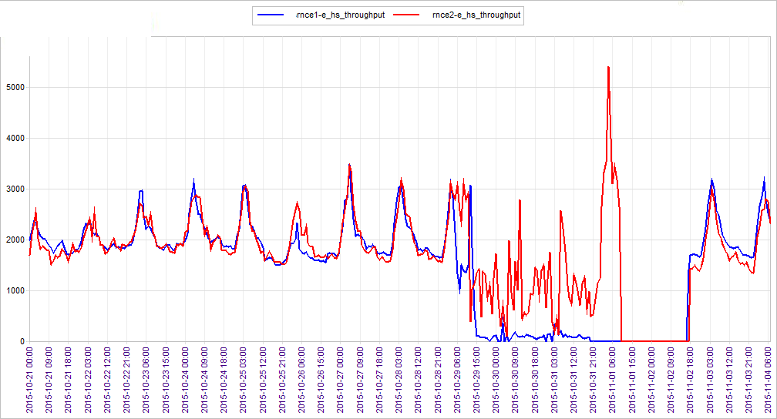
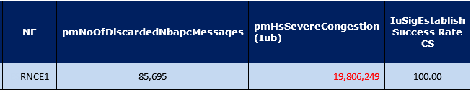
IUB Congestion
City | Site | pmNoOfDiscardedNbapcMessages | pmNoFailedAfterAdm | pmTotalTimeIubLinkCongestedDl
City 1 | Site 1 | 437868 | 262488 | 391
City 1 | Site 2 | 170304 | 59808 | 192
City 1 | Site 3 | 165246 | 70926 | 223
City 1 | Site 4 | 161658 | 69114 | 212

Slide 5
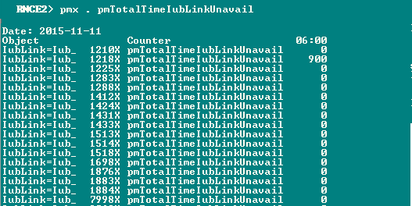
IUB Unavailability

Slide 6
IubLinks/AbisLinks Status
RNCE1> str
151201-17:12:33 10.139.153.16 11.0b RNC_NODE_MODEL_V_3_4701 stopfile=/tmp/28429
0% ~50% ~100%
MOD IUBLINK CELLNAMES CFRPHEU1 CFRPHEU2 CFRPHEU3 CFRPHEU4 CFRPHEU5 CFRPHEU6 ICDS TN TNPORTS
---------------------------------------------------------------------------------------------------------------------
1054 Iub_UE1773X UE1773XA-1/1/1/2/2/2 111111 111111 111111 111111 111111 111111 1111 I
1055 Iub_UT9727X UT9727XA-1/1/1/2/2/2 111111 111111 111111 111111 111111 111111 1111 I
1064 Iub_UT7479X UT7479XA-1/1/1/2/2/2 111111 111111 111111 111111 111111 111111 1111 I
1065 Iub_UT9624X UT9624XA-1/1/1/2/2/2 111111 111111 111111 111111 111111 111111 1111 I
1085 Iub_UT9852X UT9852XA-1/1/1/2/2/2 111111 111111 111111 111111 111111 111111 1111 I
1094 Iub_UT9827X%1 UT9827XA-1/1/1/1/2/2 111111 111111 111111 111111 111111 111111 1111 I
1094 Iub_UT9827X%2 UT9827XC-2/2 111111 111111 1111 I
ollowing 42 sites are totally or partially unavailable:
---------------------------------------------------------------------------------------------------------------------
MOD IUBLINK CELLNAMES CFRPHEU1 CFRPHEU2 CFRPHEU3 CFRPHEU4 CFRPHEU5 CFRPHEU6 ICDS TN TNPORTS
---------------------------------------------------------------------------------------------------------------------
3106 Iub_UT0320Z UT0320ZA-1/2 L000LL L000LL L000 I
3136 Iub_UT7029X UT7029XA-1/1/1/2/2/2 L000LL L000LL L000LL L000LL L000LL L000LL L000 I
3155 Iub_UT9123X UT9123XA-1/1/1/2/2/2 LLLLLL LLLLLL LLLLLL LLLLLL LLLLLL LLLLLL L000 I
---------------------------------------------------------------------------------------------------------------------
Cell availability: 920 of 1148 cells are up (80.1 %)
Site availability: 155 of 197 sites are fully operational (78.7 %)
Unlocked Cell availability: 920 of 942 unlocked cells are up (97.7 %)
HS availability: 920 of 1148 channels are up (80.1 %)
EUL availability: 920 of 1148 channels are up (80.1 %)
str[12ft] Print status of the IubLinks/AbisLinks and their associated Cells and Channels

Slide 7
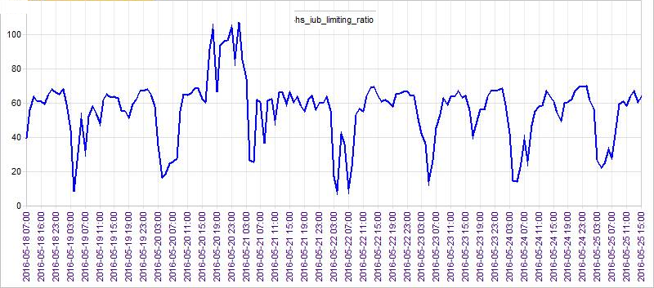
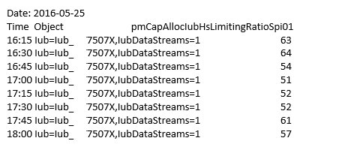
IUB Congestion

Slide 8
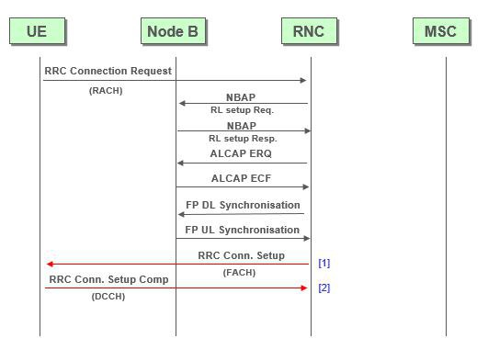
NBAP
In the 3GPP UTRAN architecture, NBAP (Node B Application Part) is the signaling protocol responsible for the control of the Node B by the RNC. NBAP is subdivided into Common and Dedicated NBAP (C-NBAP and D-NBAP), where Common NBAP controls overall Node B functionality, and Dedicated NBAP controls radio links to specific UE. NBAP forms part of the Iub interface.
Example 1: High Failures after Admission on Multiple sites in specific location due to possible transport congestion as these sites also have high NBAP discards
Command in RNC (NBAP Discard)
High NBAP discards cause:
MPload rejections
DL Hw rejections, DL code rejections,
DL power rejections,
UL HW rejections

Slide 9
NTP Server Reachability Fault Alarm (1)
Alarm Cause
IP network problems (The traffic on the network is disturbed. This can be caused by high traffic load or a hardware fault.
Communication problems toward NTP server Unable to communicate with NTP server (due to misconfiguration or because the NTP server is disabled.)
Wrong IP address (IP address is invalid or it points to a host that is not an NTP server.)
DNS problems The DNS is not performing its task in translating domain names into valid, up-to-date IP addresses.
Wrong domain name DN (domain name) cannot be resolved, DN resolved to a host that is not an NTP server, DN resolved to a non-existent host

Slide 10
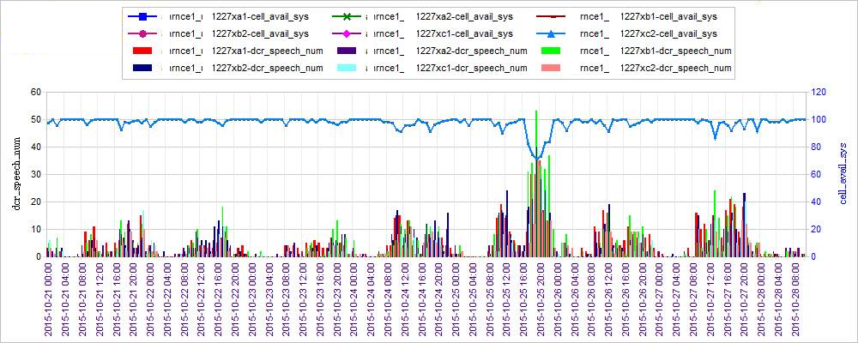
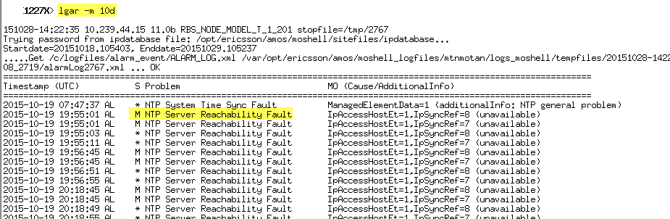
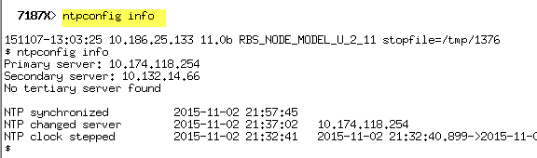
NTP Server Reachability Fault Alarm (2)
The alarm is issued when a Network Time Protocol (NTP) client detects a ‘‘not reachability’’ condition toward an NTP Server, which has been configured as an IP synchronization reference.
Impact:
No impact on traffic, if there is a working standby synchronization
reference. Otherwise, the Traffic disturbances.

Slide 11
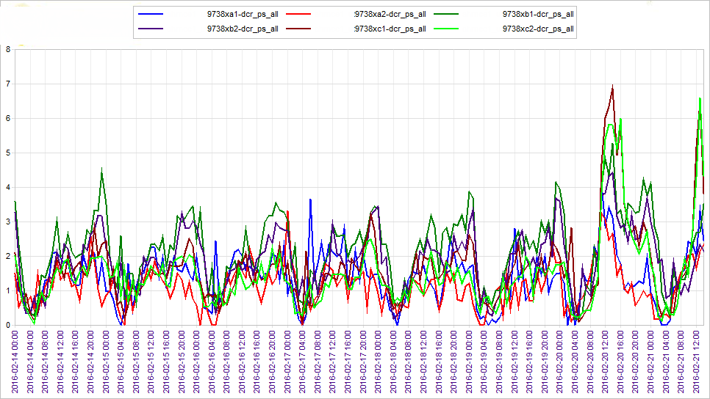
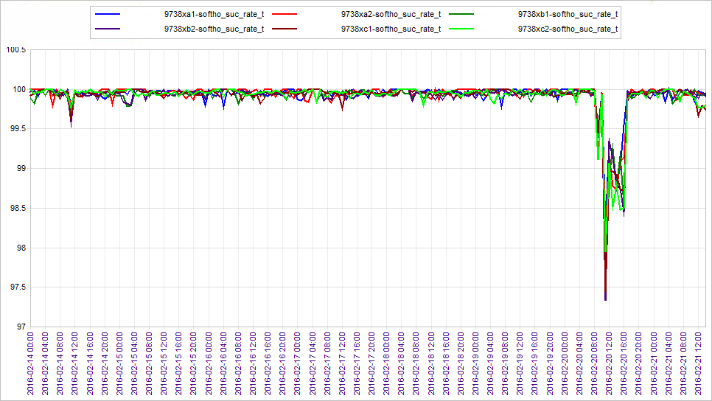
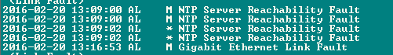
NTP Server Reachability Fault Alarm (3)

Slide 12
TTI
while in HSDPA resources are allocated per TTI.
Short TTI, 2ms in order to support fast retransmission, fast link adaptation, fast scheduling and short round trip delay

Slide 13
The HSDPA concept is based on the following features:
Shared channel transmission
Higher-order modulation
Short transmission time interval (TTI)
Fast link adaptation
Fast scheduling
Fast hybrid automatic-repeat-request (ARQ).
HSDPA Scheduling
The HSDCPA channel is a shared channel that can be shared in time using its 2 msec Transmission time interval (TTI) and codes where the SF 16 codes available for HSDPA can be shared between up to 4 users in one TTI

Slide 14
EUL Channels
Uplink HSUPA channels
A variety of new channels have been introduced for HSUPA to enable the system to carry the high speed data. These new channels are:
E-DCH, the Enhanced Dedicated Channel: This HSUPA uplink channel carries on block of data for each TTI (Transmission Time Interval). The E-DCH can be configured simultaneously with one or more DCHs. In this way high speed data transmission can occur at the same time and on the same UE as services that use the standard DCH. As a low latency (delay) is one of the key requirements for the high speed uplink a short TTI (Transmission Time Interval) of 2 ms is supported in addition to one of 10 ms. The short TTI allows for rapid adaptation of transmission parameters and it reduces the end-user delays. There is a balance to be determined for the TTI. It is found that the physical layer processing is proportional to the amount of data to be processed, and accordingly the shorter the TTI the lower the level of data per TTI. However for applications requiring relatively low data rates, the overheads required with a 2 ms TTI may be unduly high. In these circumstances a longer TTI is more appropriate. The E-DCH is mapped to a set of E-DCH Dedicated Physical Data Channels.
E-DPDCH (Enhanced Dedicated Physical Data Channel): This HSUPA uplink channel carries uplink user data. Each UE can transmit up to four E-DPDCH channels at a spreading factor of SF256 to SF2. The number of E-DPDCHs s and their spreading factors are varied according to the instantaneous data rate required. As an example of a typical scenario, to achieve a 2 Mbps rate - the raw data rate of early devices - two SF2 E-DPDCHs were required.
E-DPCCH (Enhanced Dedicated Physical Control Channel): This HSUPA channel carries the control data required by the Node B to decode the uplink channels including the E-DCH Transport Format Combination Indicator which indicates the block size, retransmission sequence number, etc.
Downlink HSUPA channels
A variety of new channels have been introduced for HSUPA to enable the system to carry the high speed data. These new channels are:
E-AGCH (Enhanced Absolute Grant Channel): This HSUPA channel provides the absolute limit of the power resources, i.e. the serving grant, that the UE may use. The channel is used to send scheduling grants from the scheduler to the UE to control when and what data rate the UE should be used. The E-AGCH is only sent by one NodeB regardless of the number that the UE is communicating with. The NodeB used is the one that has the main responsibility for the scheduling operation. The E-AGCH is typically used for large changes in data rate.
E-RGCH (Enhanced Relative Grant Channel): This channel is used to move the UE serving grant up, down or remain the same. This HSUPA channel is generally used for relatively small changes during an ongoing data transmission. Large changes are handled by the E-AGCH.
E-HICH (Enhanced DCH Hybrid ARQ Indicator Channel): This HSUPA channel is used to provide the acknowledgement of the UE data received by the Node B.

Slide 15
Paging

Slide 16
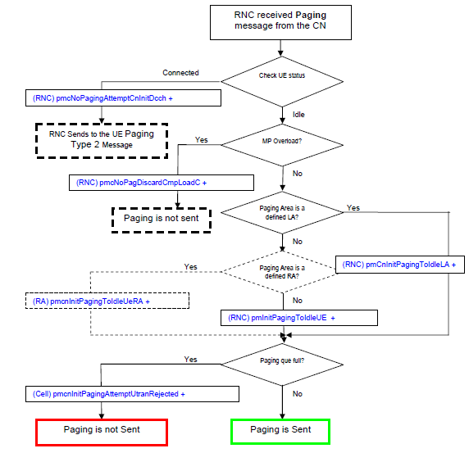
Paging Process
A paging message for a CS call to a certain UE is broadcasted to all cells belonging to the LA in which the UE is registered. Accordingly, a paging message for a PS connection is broadcasted to all cells in the RA in which the UE is registered.
Paging is initiated upon request from the CN or triggered in UTRAN.
• UE terminating service request for PS or CS services (CN initiated). CN initiated paging is applicable to UEs in idle mode.
• UTRAN initiated broadcast to inform UEs when System Information is modified. UTRAN initiated paging is used whenever System Information (e.g. information about cell selection/ reselection, addition/replacement of neighbors, handover etc.) has been updated.
The paging record varies in length depending on whether it includes the UE identity in terms of IMSI, TMSI, or P-TMSI. A PCH frame can carry one “Paging Type 1” message of 10 ms and may contain between 3-5 paging records, depending on whether the paging uses IMSI or TMSI/P-TMSI.
When the UE mode is Cell_FACH or Cell_DCH common or dedicated physical channels are already in use and the paging message “Paging Type 2” will be used.

Slide 17
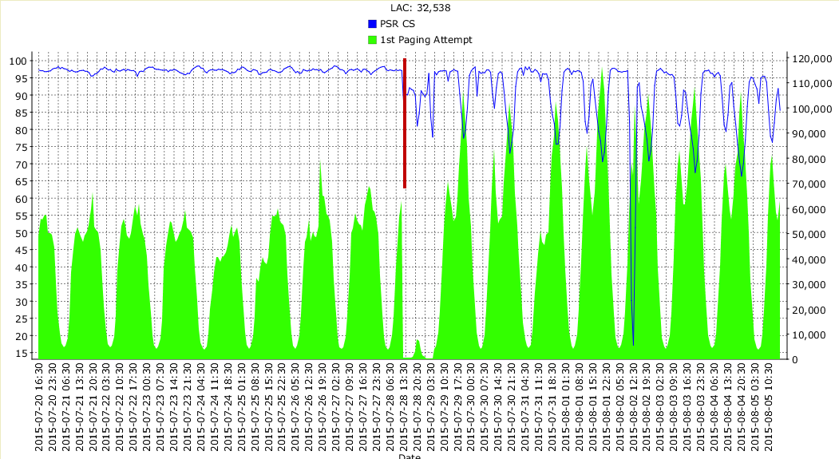
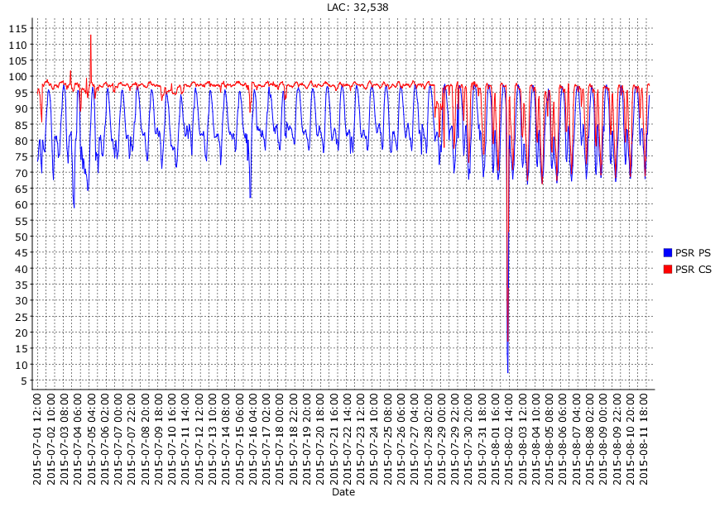
SDATE | INTERVAL | NE | CN INIT PAGING TO IDLE UE LA | CN INIT PAGING TO IDLE UE | CN INIT PAGING TO IDLE UE RA | CN INIT PAGING TO URA UE | UTRAN INIT PAGING TO URA UE | UTRAN Paging Rejection
07-Nov-15 | AH | RNCE2 | 4,910,031 | 0 | 11,414,735 |  |  | 1,326
07-Nov-15 | AH | RNCE1 | 5,298,166 | 0 | 13,442,153 |  |  | 365
07-Nov-15 | AH | RNCE3 | 4,325,182 | 0 | 9,273,015 |  |  | 96
the paging attempts on the LAC went to almost zero for few hours when the issue started and BH attempts have doubled since then. It seems that any activity/change was done in Core on the mentioned date

Slide 18
Feature

Slide 19
Features
confb+ gs+ lset . featureStateHsdpaMc 1 lset . featureState16Qam 1 lset . featureState64QAM 1 lset . featureStateEnhancedLayer2 1 lset . featureStateHsdpaDynamicCodeAllocation 1 lset . featureStateHsdpaFlexibleScheduler 1 lset . featureStateHsdpaIncrementalRedundancy 1 lset . FeatureStateHsdpaImprovedLinkAdaptation 1 lset . featureStateEul2msTti 1 lset . featureStateGrake 1 lset . featureStateHsdpaMcInactCtrl 1 lset . featureStateDlPowerControlEul 1 lset . steeredHsAllocation false lset . featureStatePerHarqProcessGrant 1 lset . featureStateIncrNumHsCodes 1 lset . maxNumHsdpaUsers 64 lset . maxNumAdchReservation 128 lset . maxNumHsPdschCodes 15 lset . hsPowerMargin 2 lset . cqiAdjustmentOn true lset . queueSelectAlgorithm 1 lset . airRateTypeSelector 1 lset . schPrioForAbsResSharing 15 lset . schMaxDelay -1 -1 -1 -1 -1 100 10 -1 -1 -1 -1 -1 -1 -1 -1 -1 lset . schWeight i[16] = 1 10 200 300 450 900 1000 4000 1 1 1 1 1 1 1 10000 lset . hsScchMaxCodePower -20 lset . hsScchMinCodePower -150 lset . eulSlidingWindowTime 72000 lset . eulThermalLevelPrior -1040 lset . maxNumEulUsers 32 lset . eulMaxNoSchEDch 100 lset RbsLocalCell=S.C1 eulMaxOwnUuLoad 80 lset RbsLocalCell=S.C2 eulMaxOwnUuLoad 80 lset . maxEAgchPowerDl -140 lset . maxUserEHichERgchPowerDl -140 lset . eulMaxRotCoverage 100 lset . eulMinMarginCoverage 10 lset . eulNoERgchGroups 16 lset . eulOptimalNoiseFloorLock eulNoiseFloorLock=false,eulOptimalNoiseFloorEsti mate=-1040 lset . eulMaxAllowedSchRate 4480 lset . eulMaxShoRate 5760 lset . eulNonServHwRate 128

Slide 20
HSDPA Features
QAM and MIMO Combination
HSDPA Incremental Redundancy
Enhanced Layer 2
Enhanced UE DRX
High Speed Downlink for FACH
HSDPA Flexible Scheduler
HSDPA 16 QAM
HSDPA 64 QAM
HSDPA Multi Carrier
HSDPA Multi Carrier Inactivity Control
HSDPA Multi Carrier with MIMO
HSDPA RBR QoS Profiling
Improved HSDPA Link Adaptation
Increased Number of HSDPA Codes for Single-Carrier Users
MIMO
Minimum Bit Rate HSDPA
F-DPCH and SRB on HSDPA
Enhanced Downlink Reception, CPC
AQM based Congestion Control for HSDPA
Channel Element Capacity for HSDPA Smartphones
Increased HSDPA Code Capacity on DUW
HSDPA MC Inter DU Joint Scheduling
HSDPA Dynamic Power Sharing
HSDPA Multi-Carrier 3 Carriers
Dual-Band HSDPA Multi-Carrier 3 Carriers

Slide 21
useful 3G optional features which exist and not exist
Quality Based Handover | not exist
Common Channel power optimization | not exist
Multi-Carrier Dynamic Power Sharing | not exist
Uplink Interference Cancellation | not exist
HSDPA UE Category Support | not exist
HSUPA UE Category Support | not exist
HSDPA Adaptive Modulation and Coding | not exist
HSDPA Multiplex | not exist
HSDPA Fast Scheduling | not exist
HSDPA CQI Adjustment | not exist
RAB Combination for CS over DCH and PS over HSDPA | not exist
HS-DSCH serving cell change | not exist
HS-DSCH handover to/from DCH | not exist
Load Balance for HSDPA Service | not exist
Power Allocation for HSDPA | not exist
Handover Optimization in Weak Coverage | exist
Neighboring Cell Monitoring | exist
Adaptive Radio Bearer | exist
CS Fallback from LTE Support | exist
Fast Return to LTE | exist
Handover Optimization in Weak Coverage | exist
Iub Interface over IP | exist
IuCS Interface over IP | exist
Iur Interface over IP | exist
Cell Broadcast Service | exist
UDP mux | exist
Handover with LTE | exist
Service Optimization for Multi-RAB | exist
Neighboring Cell Monitoring | exist
Service-Based Handover | exist

Slide 22
EUL Features
Downlink Power Control for Enhanced Uplink
EUL 2ms TTI
EUL in Two Baseband Pools
EUL TD Scheduling
Per HARQ Process Grant
Enhanced Uplink Transmission, CPC
Advanced Receivers, GRAKE in RBS
Channel Element Capacity for EUL Smartphones
Enhanced Uplink Ladder E
UL Efficiency - DCH/EUL Load Balancing
Interference Suppression
Improved Layer 2
EUL on Cell FACH
CE Extension for EUL
Interference Suppression for EUL 10 ms
EUL Multi-Carrier

Slide 23
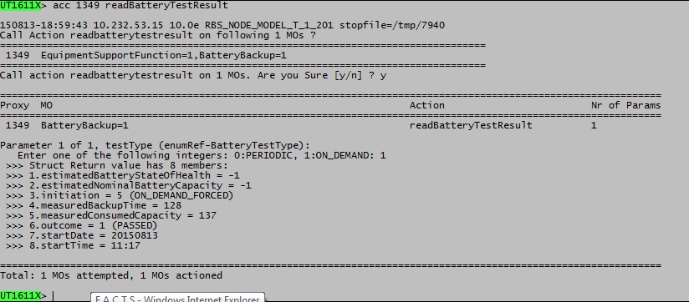
Battery test basic feature activation ?

Slide 24
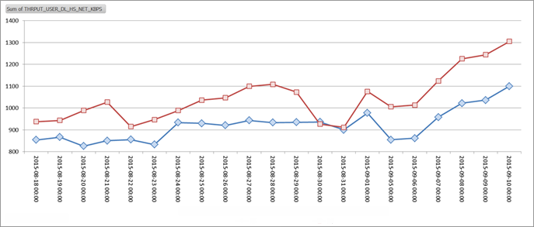
HSDPA Flexible Scheduler Features for improving the Throughput
Benefits
This feature provides the flexibility of trading system capacity with fairness among users on cell level
Description
The scheduler transmits information to users on a per 2 ms TTI (Transmission Time Interval) basis. Several aspects are considered when deciding which Ues to transmit to. These aspects include:
• UE radio channel measurements, CQI (Channel Quality Indication), with the potential of increasing system capacity by favouring users with good radio condition.
• Delay and average bit rate, with the potential of increasing fairness among users.
• Re-transmission, with the potential of favouring users with scheduled retransmissions
Parameters:
The flexible scheduler is operator configurable on cell level to one of the following strategies:
• Max CQI
• Proportional Fair - low fairness
• Proportional Fair - medium fairness
• Proportional Fair - high fairness
Round Robin (does not need Flexible Scheduler)
• Equal bit rate
Flexible Scheduler is a pre-requisite for Code Multiplexing and HS-SCCH Power Control optional feature

Slide 25
HSDPA Code Multiplexing and HSSCCH Power Control Features for improving the Throughput
Summary
Code multiplexing is a complementary method to time multiplexing (which was introduced in P4) that gives the possibility to share the HS-DSCH resource among users in both code and time domain, thereby improving the overall performance in terms of system throughput and number of users served at a given delay HS-SCCH power control reduces the RBS output power needed for the HSSCCHs and thereby increases the system capacity.
Benefits
This feature
• Improves the system throughput
• Improves the delay characteristics, especially for users downloading small objects, e.g. Web pages
• Reduces RBS output power for HS-SCCH signaling
Description
Code multiplexing is a complementary method to time multiplexing that gives the possibility to share the HS-DSCH resource among users in both code and time domain. The scheduler can transmit information to up to 4 users per 2 ms TTI (Transmission Time Interval) by using separate codes, or group of codes, per user. The codes to be received by a certain UE are signalled on HS-SCCH. HS-SCCH power control exploits e.g. UE measurements to adapt the HSSCCH output power. In this way, users close to the RBS will have less HSSCCH output than users far away from the RBS. The overall target is to reduce the average RBS output power needed for the HS-SCCHs. As such, the HSSCCH power control gain increases with the allowed number of users per TTI, c.f. code multiplexing.
Parameters
It will be possible for the operator to control:
• The number of HS-SCCHs for code multiplexing
• Operation of HS-SCCH power control by suitable parameters such as minimum and maximum HS-SCCH output power as well as update rate.

Slide 26
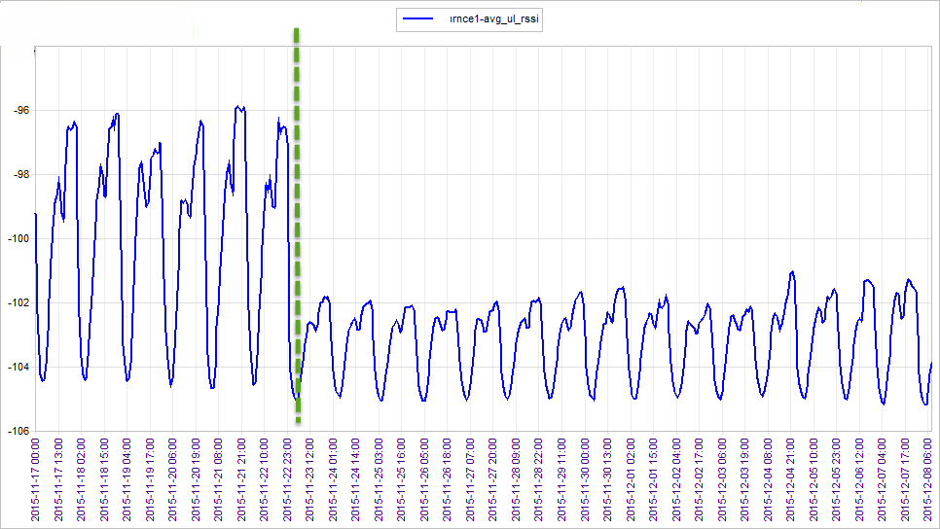
Interference Suppression
The Interference Suppression is an advanced receiver enhancement for DUW. It brings significant performance gains for EUL, which in turn lowers interference levels also for other radio bearers. Interference Suppression is supported in deployment scenarios with 1, 2, or 4 receiver antennas.
The Interference Suppression receiver replaces the existing G-Rake receiver and improves equalization, SIR estimation, and interference suppression (interference mitigation) capabilities. The NodeBFunction::featureStateInterferenceSuppression
attribute controls whether the feature is enabled. The Interference Suppression licenses is required. This feature is only available for DU-based RBS.

Slide 27
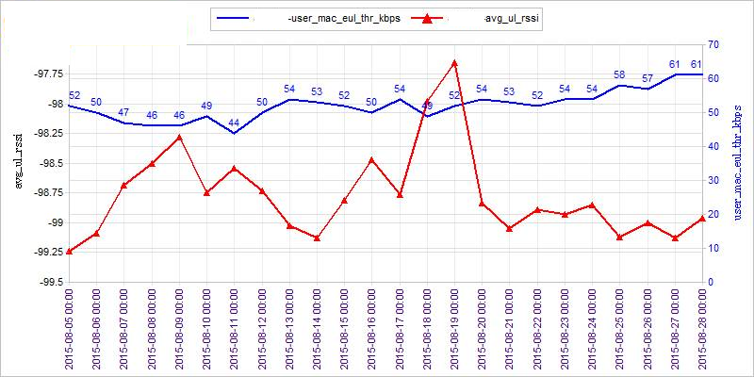
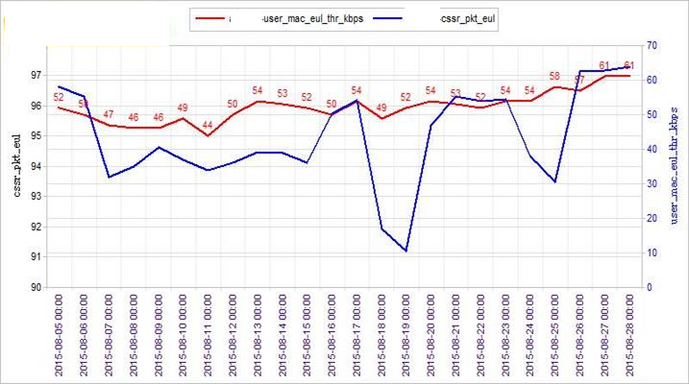
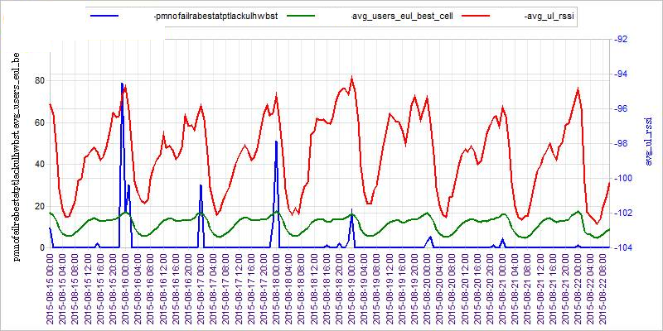
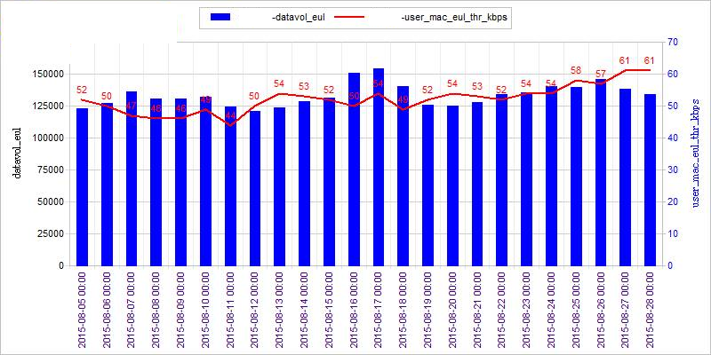
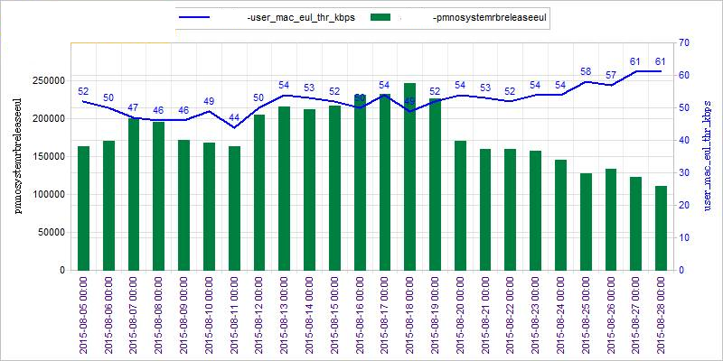
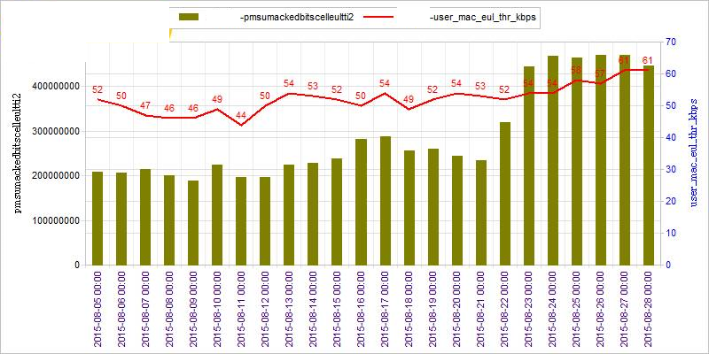
EUL 2ms TTI increase
The EUL 2ms Transmission Time Interval (TTI) feature provides:
higher uplink bit rates
lower latency.
The NodeBFunction::featureStateEul2msTti attribute controls whether the feature is enabled. The EUL 2ms TTI license is required.
Candidate RNC must has the following circumstances:
Good number of average EUL best users
Good UL RSSI
Minimum UL hardware admissions

Slide 28
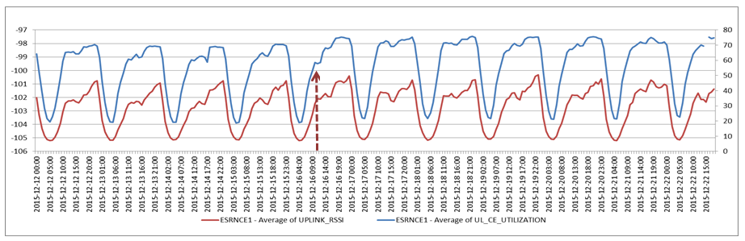
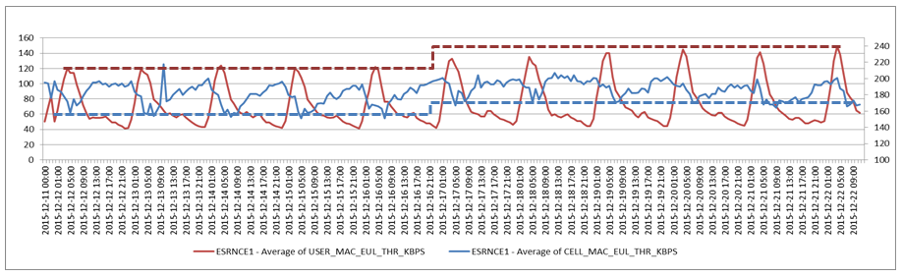
2ms TTI users admission
The 2ms TTI users admission increase from 4 to 12. Overall we have increase in both Cell and User Throughput which increase in UL CEL utilization, both static and dynamic

Slide 29
Moatch

Slide 30
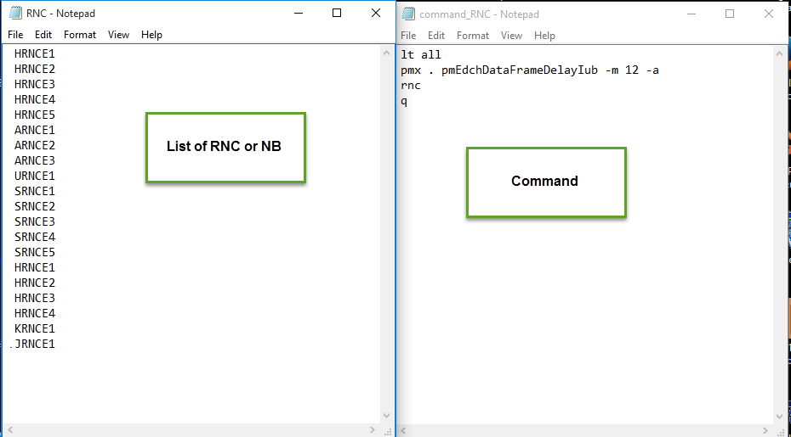
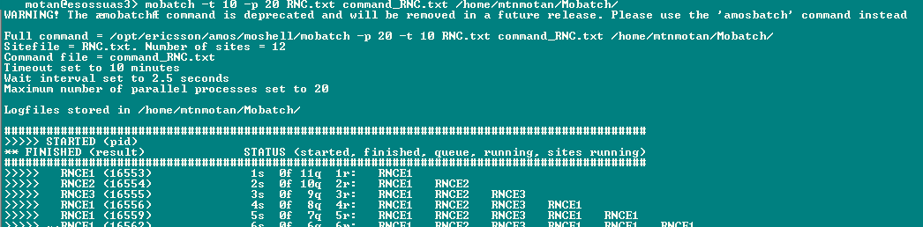
cd mobatch
ls

Slide 31
Cases

Slide 32
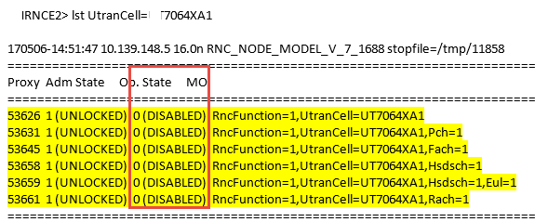
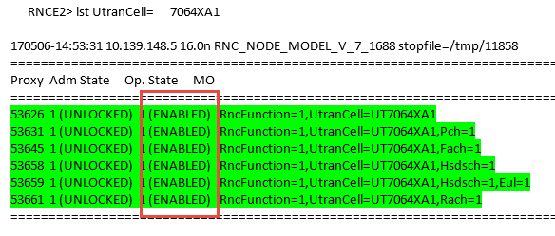
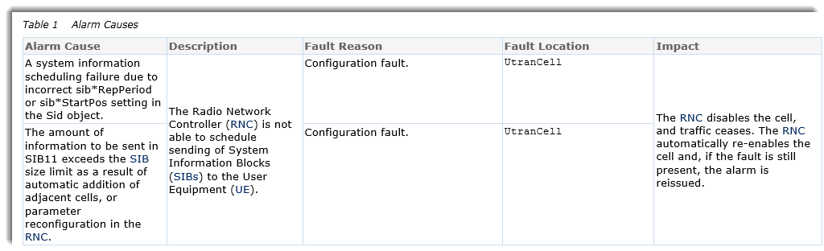
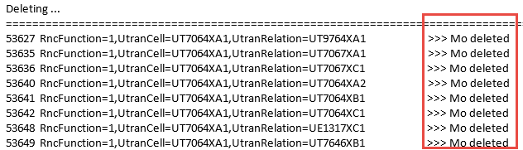
Cell Disable due to RncNotAbleToScheduleSibs alarm
Issue is related to wrong relation plan. There was relation creation and cell parameter

Slide 33
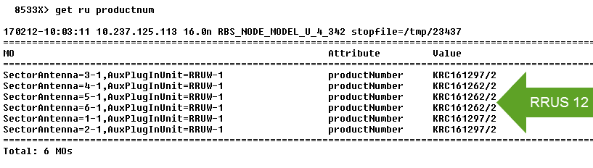
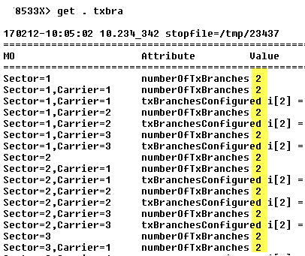
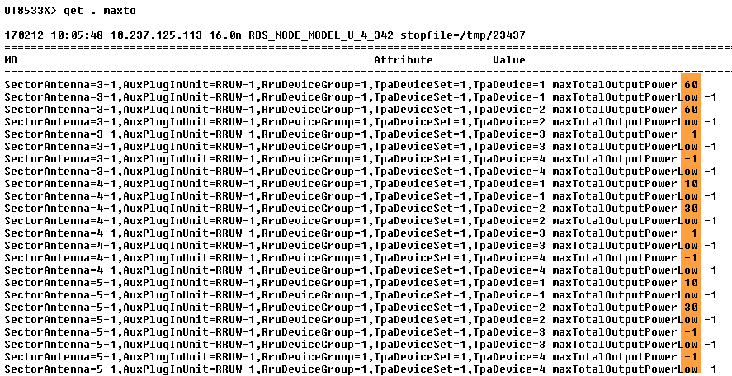
Unbalance MaxTotalOutputPower in RRUS 12

Slide 34
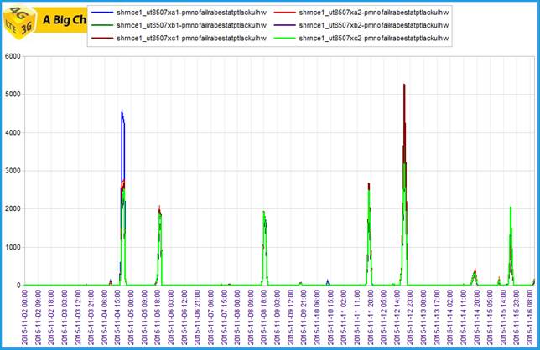
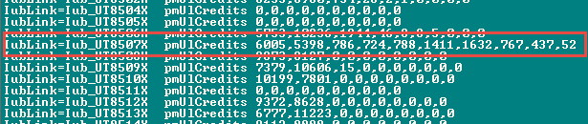
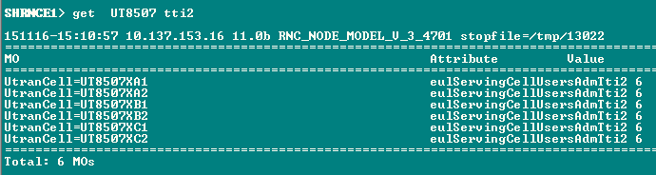
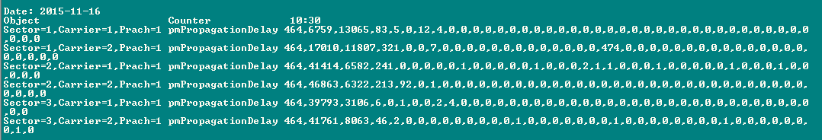
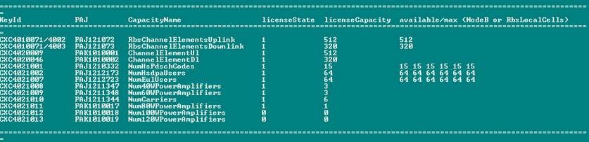
CE congestion? 1k komand?
The CE congestion suffers this site. The overshoot and capacities (as below) were checked. There is not overshooting . Finally it should be reduced the TTI2 from 6 to 4

Slide 35
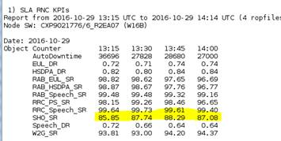
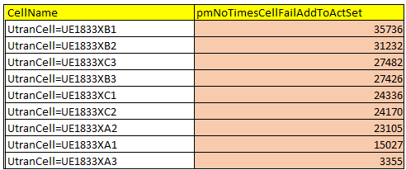
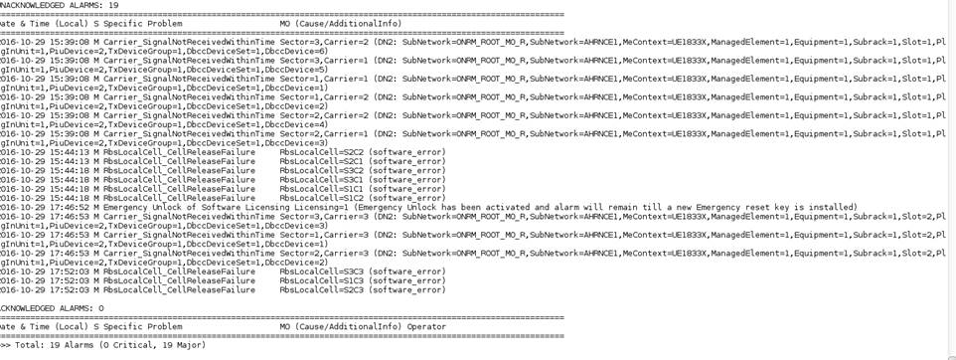
SHO degradation due to many alarms

Slide 36
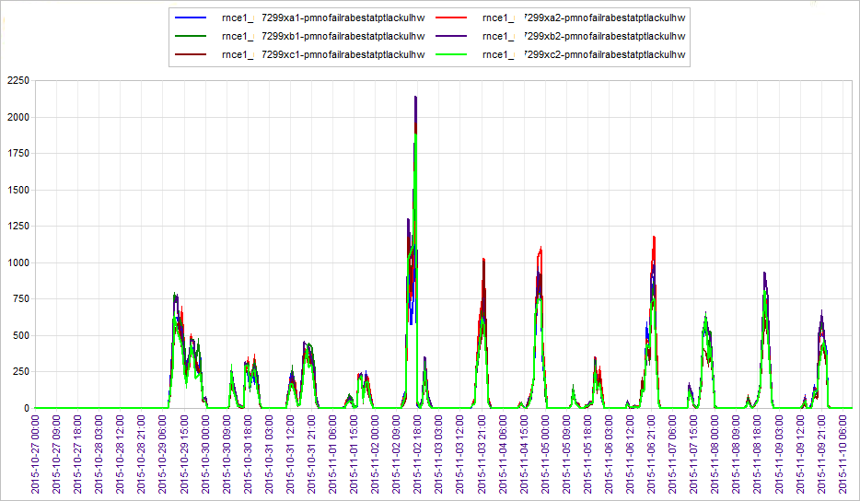
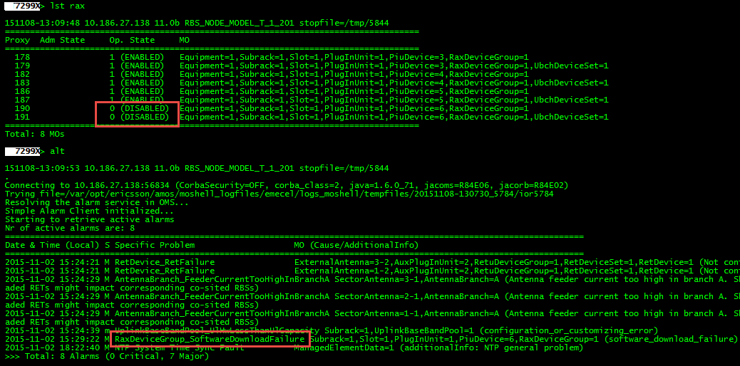
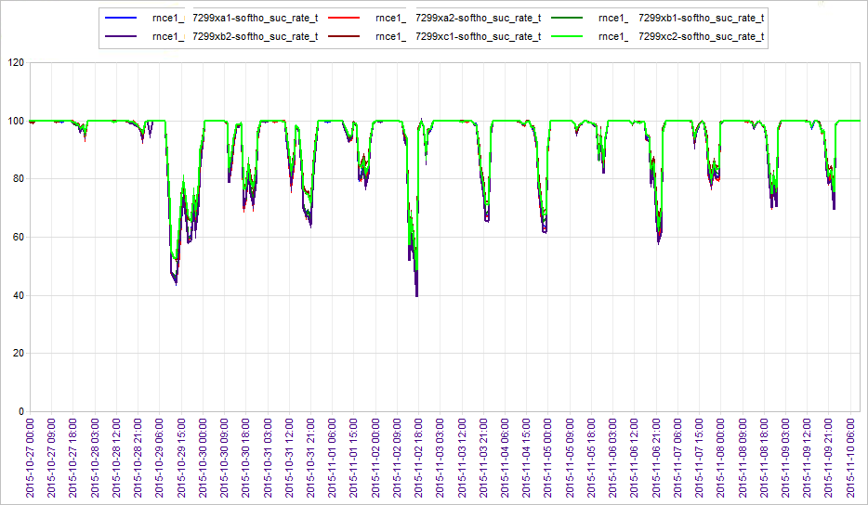
RAX
The RaxTXInterfaceCommunicationError alarm is primary alarm. The alarm is issued by the RaxDeviceGroup Managed Object (MO) or theTXDeviceGroup MO
Alarm Cause | Description | Fault Reason | Fault Location | Impact
Equipment malfunction | The alarm issued when there is a communication error between the Transmit (TX) board and the Random Access and Receiver (RAX) board. The connection is made through the backplane. | Software fault | RaxDeviceGroup TxDeviceGroup | Each TX board can handle several RAX boards. Depending on the configuration, the consequence of the fault is that the RBS capacity is reduced or that the RBS is unable to carry any traffic.
This alarm is triggered when the installed license key file defines a capacity that is greater than the available capacity for DCH given by the installed Random Access and Receiver (RAX) boards. It can also be triggered due to a HW failure on one of the RAX boards which decreases the available capacity below the capacity defined by the license key. A faulty RAX board (see alarm: RaxDeviceGroup_GeneralSwError/ RaxDeviceGroup_GeneralHwError) is the general cause of this alarm however if all RAX boards are operational and showing no errors this alarm will need to be escalated to Planning/Optimisation to consider increasing the UL capacity on the site.

Slide 37
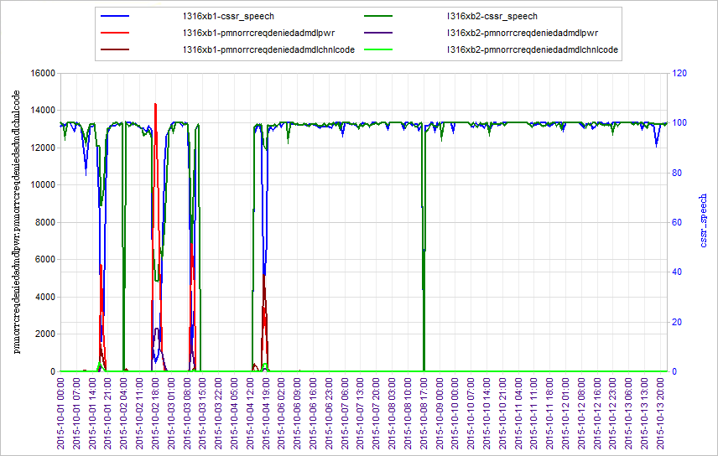
high rejections due to overshooting

Slide 38
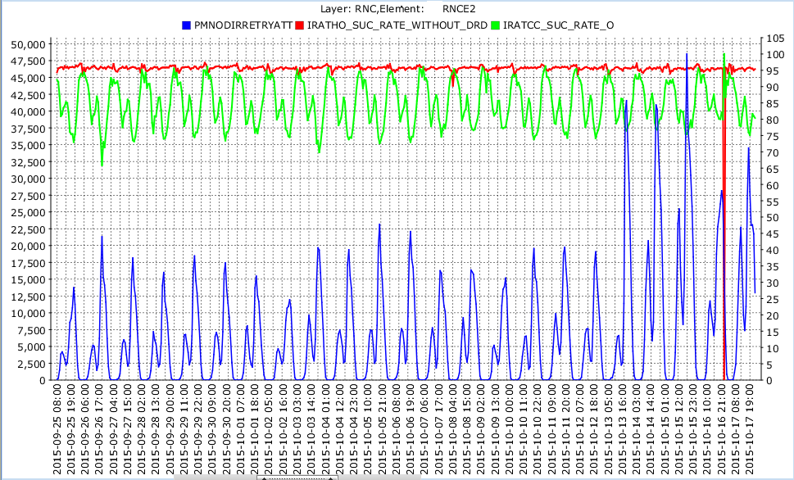
Direct Retry IRAT HO
IRAT affected due to increasing attempts of directed retry due to power congestion in some cpichpower increased sites

Slide 39
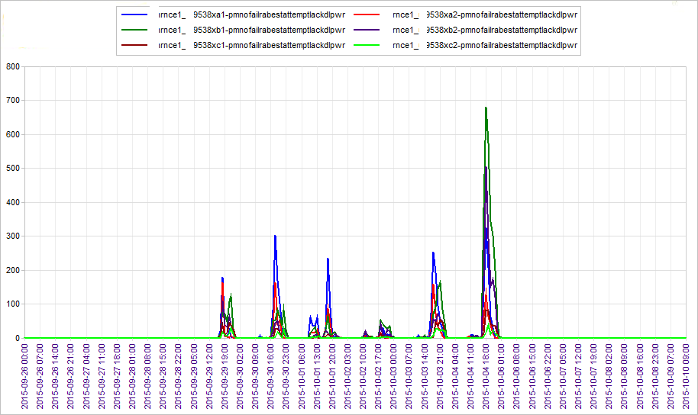
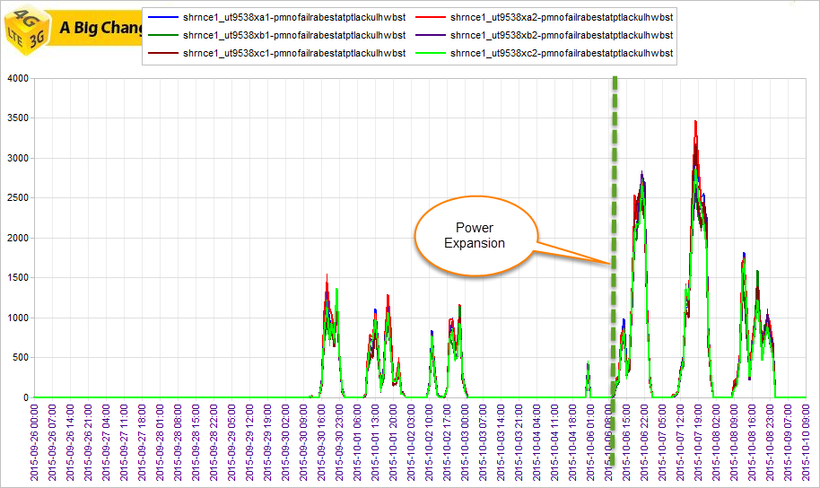

CE congestion Issue after expansion Power Congestion
The mentioned site encounters the PWR Congestion, after expansion it suffers the CE Congestion.
After Expansion the site encounter the CE Congestion
The ulHwAdm must be set at high level (99)
Sometimes the RbsChannelElementsUplink has low value and the ULHW must be expand

Slide 40


High UL RSSI
Issue: The UL RSSI reading on Node B is high (ranging -70 to -80 dBm) while normally should be -100 to -108
Causes:
Subscriber behavior (UE with high RSSI)
interfered area by RF signal (jammer)
Tx link fluctuation
Congested Transmission Link
TMA is installed but it is not defined
when it is accompanied by abnormal Drops and there is nothing to suggest bad radio conditions such as overshooting, there is a high possibility that it has got some Rx path hardware issue
In last case, this is generally rectified by the site engineer, replacing the faulty RU, feeder, antenna etc.
non-traffic interference
High TX power from a UE that are connected to a far cell. This can happen due to missing neighbors
RTWP Vs. RSSI

Slide 41


High UL-RSSI due to missing Neighbors
The site’s cells suffer the high UL-RSSI in general but at 15th Nov. it enhanced more. It re-homed from BSC to another one in 2G part at that time, and also the IRAT HO with relocation has degraded.
the inter system relation definition should be revised.

Slide 42


High UL-RSSI due to Congested link
Link between two sites is congested and causing low RSSI

Slide 43


DL traffic ps16 and ps128 has been increased on RNC
One site had very high DL H/W congestion and almost no HS/Eul traffic since the 7th. CV has been re loaded and is now taking Eul/HS traffic.

Slide 44



Payload and throughput degrade due to UGW
An issue with UGW which has affected both 3G as well as 2G’s payload and throughput.
All UGWs affected in Region due to possible Gi Interface issue

Slide 45

Alarm that affect Traffic
Sector C is not taking any traffic and has the
following alarm
Date & Time (Local) S Specific Problem MO (Cause/AdditionalInfo)
====================================================================================================================
2014-11-28 07:09:40 C License Key File Fault Licensing=1 (No license key file installed. IntegrationUnlock=ACTIVATED, 16 days remaining)
2014-11-28 07:09:52 m InconsistentConfiguration Subrack=1,Slot=1,PlugInUnit=1,EcPort=1 (Attribute hubPosition is empty or not valid)
2014-11-28 07:12:18 M DigitalCable_CableFailure DigitalCable=3_1_RI_C (DN2: SubNetwork=ONRM_ROOT_MO_R,SubNetwork=RNCE2,MeContext=1601X,ManagedElement=1,Equipment=1,Subrack=1,Slot=1,PlugInUnit=1,PiuDevice=1,DeviceGroup=DUI DN3: SubNetwork=ONRM_ROOT_MO_R,SubNetwork=RNCE2,MeContext=1601X,ManagedElement=1,Equipment=1,SectorAntenna=3-1,AuxPlugInUnit=RRUW-1,RruDeviceGroup=1)
2014-11-28 10:08:51 M NTP System Time Sync Fault ManagedElementData=1 (additionalInfo: NTP general problem)

Slide 46


Case: Speech Drop
Issue:
High speech drops on one site due to overshooting
Solution:
RET installation has been requested. CPICH power reduced by 1 dB temporarily

Slide 47




DCR HS
DCR HS degraded due to hardware issues in a site, specifically alarms such as temperature exceptionally high and Piu conn lost are toggling.

Slide 48





Emergency License
This site has very high power congestion since it came on. As it’s on Emergency license. 80 watts for sector C and 60 for the others have been activated . Request for 60 Watt expansion for ll sectors as it will again be congested once the EM License expires. In addition to the power admission for Sector C has been increased to 95. In site life we can use only 2 times

Slide 49

MP Load
Subrack Identity | Local Distinguished Name | Description
Main Subrack | ManagedElement=1,Equipment=1,Subrack=MS | The MS in an RNC.
Extension Subrack | ManagedElement=1,Equipment=1,Subrack=ES-2 | The 2nd ES in an RNC.
Slot in MS | ManagedElement=1,Equipment=1,Subrack=MS,Slot=7 | The 7th board in the MS.
Slot in ES-2 | ManagedElement=1,Equipment=1,Subrack=ES-2,Slot=12 | The 12th board in the second ES
The module MP handles signaling associated with traffic events. Connection setup and release (Speech, PS R99, HS, LA update, SMS).
RncModule: Create this MO on the MP to group IubLinks in a way to minimize inter-processor communication
variations in packet delay along the path,
i.e. packet delay variation (PDV), also impacts accuracy (Synchronization Ericsson WCDMA doc)
Total number of pages discarded due to central MP load control for a RNC pmNoPageDiscardCmpLoadC
UtranCell=7105XC2 | pmNoRejRrcConnMpLoadC | 15847
UtranCell=7105XC1 | pmNoRejRrcConnMpLoadC | 15444
UtranCell=7105XB2 | pmNoRejRrcConnMpLoadC | 14532
UtranCell=7105XB1 | pmNoRejRrcConnMpLoadC | 13764
UtranCell=7105XA2 | pmNoRejRrcConnMpLoadC | 9979
Load control refers to the RNC MP load
MP implements overload protection
Load control applies prior to RL setup (subject to RN AC)
If MP load exceeds 85%, RRC setup requests are rejected
MP load: observed with counters of the LoadControl MOC
Failures due to MP load: pmNoRejRrcConnMpLoadC

Slide 50


Device failure
high failures after admission on multiple sites occurred
Device ES-1-11 and ES-2-16 locked and issue has recovered.
NBs which are attached to particular device will be automatically be shifted to other active devices.
But definitely if the MP load on other devices will increase and if the other devices are already on a high load, it might result in MP load rejection on that particular device, that’s why its always recommended to check the RNC MP load before locking any devie.
lget iublink=iub. rncmodule
lget iublink=iub. rncmodule RncModule=ES-2-17-4

Slide 51



Co-Scrambling Code
Two Sites have the Same Scrambling code for all Cells (all sectors have primaryScramblingCode=0)
After changing the Scrambling code, the improvements have achieved.

Slide 52


CSSR_PS due to MPLOAD
high traffic sites and DL CE congestion has increased after URA implementation.
For Cope with the DL CE in site level
change dlHwAdm to 99, sf16Adm to 0
sf16gAdm to 0

Slide 53

RRC level code congestion (pmNoRrcreqdeniedAdmDlChanlCode)
numhsscchcodes (3→4) increased
RNC>get UtranCell=1805XA1, numHsScchCodes
Definition???
dlcodeadm (90→ 99)
RNC> get 1805 dlcodeadm
Definition???

Slide 54


Speech Drops due to Power Congestion
The releaseAseDl parameter minimizes the speech drops caused by DL power congestion
Parameter Description:
Amount of ASE in the downlink to be released with each periodic congestion-resolution action targeting the guaranteed traffic class connections in this cell. 0 indicates that no ASE is released for guaranteed traffic class connections. This prevents congestion-resolution actions on the guaranteed traffic class connections in the cell. Range: 0 to 500, Default=1
Changing the value from default 1 to 0 means, now congestion control will not release a guaranteed traffic class connection.
The releaseAseDlNg uses for the non-guaranteed traffic

Slide 55



UL Sync Drops
This specific cell is suffering from high UL Sync drops since the 26th with loss of traffic. The delta between RSSI in Sector C for carrier 1 which is ~10 dB . We must arrange to visit the site.
pmNoSysRelSpeechUlSynch
Number of system disconnections due to lost uplink synch for calls that included any CS Conversational Speech RAB (including AMR Single-mode 12.2, AMR-NB Multi-mode single- and multi-rate, and AMR-WB). Condition: Incremented by one in the best cell in the active set prior to the call release, when a CS Conversational Speech call is released by the network after expiry of the timer defined by Rrc::dchRcLostT.

Slide 56







LKF (License Key File)

Slide 57



Slide 58


CSSR degradation due to frame lost
Site having transmission problems.
The PM counter counts lost or discarded HS-DSCH data frames in RBS.
For instance, Spi02 is valid for scheduling priority class 02 The SPI and GBR are the two primary parameters that can be used to control the QoS differentiations on HSDPA. The GBR can be set for a user with minimum target bit rate while the SPI can be set to give priority to data flow to achieve that target.

Slide 59

HS Frame Lost due to IuB congestion
high Iub HS/EUL capacity limitations & HS Frames Lost
RNC | Sie | Average of MAX(PMCAPALLOCIUBHSLRSPI01) | Average of EUL_LIMITING_RATIO | Average of HS_FRAMES_LOST_RATIO
RNCE2 | 9519X | 87.5 | 0.00 | 22.50%
RNCE2 | 7557X | 86 | 0.00 | 21.17%
RNCE2 | 9747X | 85.5 | 0.00 | 21.15%
RNCE2 | 7062X | 85.66666667 | 0.05 | 21.10%
RNCE2 | 7042X | 85.66666667 | 0.00 | 20.64%

Slide 60





Check the Max and Min Tilt for calibration
Calibrating the RET
A calibration of the RET is performed to find the limits of the antenna tilt and the actuator is driven through the whole tilt range of the controlled antenna element.
Before calibrating an RET, a connection to the ARETU or RETU must be established.
To calibrate an RET, start the action forceCalibration in the RetDevice MO.

Slide 61

Cabinet change activity on site (Discrepancies in R99 ADM parameters)
Baseline settings were changed by Field team during DUW change activity
Maxnumeulusers
Maxnumhsdpausers
NumHsPdschCodes
Maxtotaloutput power
RNC | sf128Adm incons. Count | sf16Adm incons. Count | sf16Adm UL incons. Count | sf16gAdm incons. Count | sf32Adm incons. Count | sf4Adm incons. Count | sf64Admul incons. Count | sf8Adm incons. Count | sf8Admul incons. Count | sf8gAdmul incons. Count
Wrong Values | 0 | 42 | 48 | 48 | 0 | 54 | 0 | 12 | 32 | 32
Correct Values | 128 | 0 | 32 | 16 | 32 | 0 | 100 | 0 | 0 | 0
####################################################################################################################################
MO Class Attribute Type Flags
####################################################################################################################################
UtranCell sf128Adm long
------------------------------------------------------------------------------------------------------------------------------------
Admission limit for non-guaranteed traffic class connections with downlink Spreading Factor (SF) = 128. This is the maximum number of radio links with SF=128 in the downlink for which new admission requests for non-guaranteed traffic classes will continue to be allowed. Reaching or exceeding this number of downlink SF=128 radio links (for non-guaranteed service classes) will block setup in this cell of more non-guaranteed traffic class radio links that would require downlink SF=128. Note that for this particular admission limit, soft and softer handovers are not blocked (though inter-frequency handovers may be blocked).
The value 128 disables the admission policy, meaning that no blocking of downlink SF=128 requests will occur.
Change takes effect: Immediately
Range: 0 to 128, Default=128
************************************************************************************************************************************

Slide 62


HS average Number of UE in Queue
HsAqmCongCtrlLicenseNotValid alarm:
When this alarm is generated and license key is disable, the cell configured for AQM based Congestion Control for HSDPA is not possible to setup.
$$\text{HS}\text{_}\text{AVG}\text{_}\text{NO}\text{_}\text{UE}\text{_}\text{IN}\text{_}\text{QUEUE}=\frac{\text{pmSumNonEmptyUserBuffers}}{\text{(}\text{pmNoActiveSubFrames}\text{ + }\text{pmNoInactiveRequiredSubFrames}\text{)}}$$

Slide 63





CommunicationLostWithRet alarm
By this alarm you cannot change the electrical tilt
This alarm will generally require an RE to go to site. Communication with the ASC/RET is lost. The consequence of this alarm is that planning/optimization will be unable to make a tilt change to the affected sector. Connection with the RET will need to be restored on site or a replacement ASC will be needed.
RBS (actions):
Alt *show current alarms
lga | grep AuxPlugInUnit_CommunicationLostWithRet *show history of current alarm
get radio no *confirm if node is carrying traffic
st plug *print state of all plug in units
Prox *do a get on the disabled proxy number
Get ret electrical
acl xxx *check what action you can perform on the proxy number
acc xxx restartAuxUnit *try restart the ASC/RET using the proxy number
RNC (Action):
moshell XXRNCX *log onto the RNC
lt all *load all Managed Objects
alt *show current alarms
lst .xxxx *show status of channels

Slide 64


failed After ADM
Carrier_SignalNotReceivedWithinTime alarm

Slide 65
Site Down (TxDeviceGroup_GeneralSwError)
The likely causes of this alarm are the following:
A software fault
An incorrect version of the software
A faulty configuration, depending on a software error (only when RruDeviceGroup issues the alarm)
In this case it is the TX board that has the problem. As a consequence the capacity of the site is decreased.
RBS:
alt *show current alarms
cab *confirm the TX boards on the site
st plug *check the state of the TX boards
acl xxx *check what action you can perform on the board using the proxy number
acc xxx manualRestart *try restart the board
Check that the alarm has cleared. If the alarm is still present an RE will need to go to site and do a hard reset or change the TX board. Confirm the site is carrying traffic.

Slide 66



Slide 67

Code Congestion
It recovered after RBS reset

Slide 68


CSSR
High failed-after-adm at two NBs;
suspected TXN issue (PDV alarm)

Slide 69


High power congestion in site due to RRU Attenuation Discrepancy
How can I find the site use RRU or not?
The correct setting?

Slide 70




CSSR-DCR degradation
Site performance degraded due to false configurations
1) get . licensecap
2) get . dlatten
3)get . maxtot
4) get . maxdlpower
maxDlPowerCapability=maxTotalOutputPower - dlAttenuation
For instance:
80 wat per cell, 40 watt per carrier (=46 dBm)
Then maxDlPowerCapability (460-7=453)

Slide 71

Affect of PWR congestion on IRAT and SHO
The PWR congestion is not very affective on IRAT but in SHO is affective

Slide 72


Find VSWR

Slide 73

Find the type of DU and RU, Temp, VSWR and Board Serial No.

Slide 74
Frame Synchronization
In the downlink direction, frames are synchronized in order to be transmitted in the air interface at a certain transmission time. The Frame Synchronization function also provides a base for macro-diversity functionality. Frame transport timing is supported within a Serving Radio Network System (SRNS) as well as between two RNSs.
The Frame Synchronization function also provides timing and numbering of the traffic frames to be transported over the Iub interface between an RNC and its associated RBS. The function applies to R99 common channels FACH and PCH and dedicated channels R99 DCH. For the data transfer on RACH and BCH, there is no Frame Synchronization related functionality in the RNC. For HS-DCH (HSPA channels), scheduling is the responsibility of the RBS, and thus the Frame Synchronization function is not used.

Slide 75



High Failures after admission and Sector C has very high UL Sync drops and loss of traffic
Alarm history: lga -a
feeder disconnection and also synchronization issue was the major issue

Slide 76


PS and CS CSSR Degradation?
Due to wrong configuration
The baseline script was run and some values are default and wrong

Slide 77


BLER
$$\text{UL}\text{_}\text{BLER}=100∗\frac{\text{PMFAULTYTRANSPORTBLOCKSBCUL}}{\text{PMTRANSPORTBLOCKSBCUL}}$$
pmTransportBlocksBcUl ------------------------------------
Total number of uplink DCH transport blocks.
Condition: Incremented by one for each valid transport block (based on the CRCI) received on UL DCH, before macro diversity combining.
PMFAULTYTRANSPORTBLOCKSBCUL------------------------------------
Total number of faulty uplink DCH transport blocks.

Slide 78



BLER Degradation
After activation of URA_PCH in RNCE the UL_BLER has degraded.
$$\text{UL}\text{_}\text{BLER}=100∗\frac{\text{PMFAULTYTRANSPORTBLOCKSBCUL}}{\text{PMTRANSPORTBLOCKSBCUL}}$$

Slide 79



URA Update Success Rate
URA_UPDATE_SUCC = 100*(pmNoUraUpdSuccess/pmNoUraUpdAttempt)
The problem occurs due to faulty DUW

Slide 80
Failures after admission (CSSR/Soft HO)
RU Fault
TN Blocking
Iub congestion
NBAP Discards
License expansion
Carrier_SignalNotReceivedWithinTime alarm
HW swap and CPRI cables
NTP Server alarms (NTP Sync Faults alarms)
Transmission Issue
DUW faulty
HW Alarms_LKF issue after 3rd carrier addition
False configurations (maxDlPowerCapability)

Slide 81
CSSR
User Blocking
RET alarm (MissingRetProfile)
Baseline parameters are not set correctly

Slide 82


CSSR (Baseline parameter was not set correctly )

Slide 83
RRC_SUCRATE_PS (UT8399)
nvl (PMTOTNORRCCONNECTREQPSSUCC,0) / (pmTotNoRrcConnectReqPs - nvl(pmNoLoadSharingRrcConnPs,0)) end, 2) RRC_SUCRATE_PS ,

Slide 84


CSSR (CLOCK Synch alarms )

Slide 85

CSSR (CLOCK Calibration alarms)

Slide 86


Iub/link problems
It was a specific case with severe degradation observed at busy hr. also observed Iub discards & HS Cap limiting ratio at same times on impact of degradation

Slide 87

DCR
Firstly the DUW was fault after investigation it found that the PSU was faulty and it’s replaced. Issue is rectified and DUW is working normally

Slide 88




Low IRAT HO
The IRATHO is poor due to the following issue
1. High ICM which is causing IRAT HO failures.
2. High TCH assignment failure rate which is also causing poor IRAT performance for 3G site.

Slide 89


Way forward
The following activities to be done to maintain and improve IRAT performance:
High Failure Relations deletion except Co-site.
SelectionPriority tuning based on succeeded IRAT attempts (detail information will be shared accordingly).
Periodic ExternalGsmCell definition audit
Penalizing poor performing GSM cells using individualoffset. (detail information will be shared accordingly).
Tuning the gsmAmountPropRepeat from 1 to 0.
Tuning the gsmThresh3a from -95 to -85 to attempt only in good radio conditions on GSM.
Copyright© 2014 MTN Irancell. All rights reserved

Slide 90
Sleeping Cell

Slide 91


Sleeping Cell 1
Cell is sleep due to SFP faulty (Small
Form-factor Pluggable)

Slide 92


Sleeping Cell 2
The cell is sleeping periodically due to RRUS faulty

Slide 93

Sleeping Cell 3
Digital Cabling Fault

Slide 94

High VSWR
Sleeping Cell 4

Slide 95


Sleeping Cell 5
Tr device failures

Slide 96

Sleeping Cell 6
The cell is not taking any traffic due to Carrier_RejectSignalFromHardware alarm

Slide 97

Sleeping Cell 7
The cell is not taking any traffic due to high RSSI

Slide 98

Sleeping Cell 8
Disable from RNC side

Slide 99
DCR
DUW is faulty
RETU alarm
Overshooting
Digital cable failure alarm
TX problem
Iub congestion
Code/User/Pwr Congestion
RSSI
PSU Faulty
LKF issue
RRUS faulty
High VSWR

Slide 100
Availability
RRU

Slide 101

Sectors are not propagating
Sometimes the RRUs/RUs get freeze due to some internal processor failure or high temperature which is not always be visible via alarms. And it stops setting up new RRC connection. If you see when the RU stopped propagation it also stopped setting up new RRC connection. And finally the NodeB was restarted

Slide 102

Give priority to neighbors based on GSM attempt

Slide 103
Important parameter & counters details

Slide 104
Useful commands
Get UTRANCELL.docx
We can change the parameters with [SET UTRANCELL= {parameter} {value}
PR IUB.docx
LST CELL.docx
Get Iub.docx
LST Sector.docx
See counter’s definition: PMOM.docx
See Parameter’s definition: MOM.docx
It will print all the counter available in the RNC (PGET)
Print all parameters (MOMD .. )
Print Electrical Tilt (Get . Electricalant) Tilt and state
To see all parameters value (KGET)
To see log of all changes in RBS (lgu)
To see the carrier frequencies : GET RBS ARFCN
To see Location Area (get UtranCell=UE2162XC0 serviceAreaRef)

Slide 105
system configuration
primaryCpichPower: Parameter that controls the power level of the Primary CPICH.
maximumTransmissionPower: Parameter that can be used to limit the total DL power in a cell to a value lower than DL power capability of the RBS. (441, 442, 460…)
maxTxPowerUl: Used in UE functions for cell selection/ re-selection in idle mode and connected mode and also used by UTRAN to control the maximum transmitted power level a UE can use. (for ExternalGsmNetwork =100 and for UtranCell=24)

Slide 106
Capacity management
compModeAdm: Absolute admission limit for the number of radio links in compressed mode in a cell. (15)
dlCodeAdm: Parameter that defines in percentage the absolute admission limit for DL code usage (90, 95, 97)
pwrAdm: Parameter that defines in percentage the absolute admission limit for DL power utilization. (85 or 95)
sf8Adm: Defines the absolute admission limit for the number of RLs with SF=8 (PS384) in DL. (0)
sf16Adm: Defines the absolute admission limit for the number of RLs with SF=16 (PS128 RAB) in DL. (32)
Admission limit for non-guaranteed traffic class connections with DL SF = 16. Maximum number of radio links with Spreading Factor
sf32Adm: Defines the absolute admission limit for the number of RLs with SF=32 (PS64) in DL. (32)
sf4AdmUl: Absolute admission limit for the number of RLs with SF=4 in UL (PS384/HS) (0)
sf8AdmUl: Defines the absolute admission limit for the number of RLs with SF=8 in UL. (0)
sf16AdmUL: Parameter that defines absolute admission limit for the number of RLs with SF=16 in UL. (32)

Slide 107
Directed retry
loadSharingDirectedRetryEnabled: An RNC-wide flag for turning on the feature.
directedRetryTarget: UA cell specific parameter that specifies the Directed Retry target in terms of a cell reference to an external GSM cell.
loadSharingGSMThreshold: A cell specific parameter that specifies the load sharing threshold below which Directed Retry to GSM is suppressed.
loadSharingGSMFraction: A cell specific parameter that specifies the fraction of qualified speech calls to be diverted to GSM.

Slide 108
handover
maxActiveSet: Maximum number of cells allowed in the Active Set.
IndividualOffset: Offset value which can be assigned to each cell. It is added to the measurement quantity before the UE evaluates whether or not an event has occurred. It can either be positive or negative value.
measQuantity1: Defines the measurement quantity for intra-frequency reporting evaluation. Default is Ec/No.
hsQualityEstimate: Indicates whether Ec/No or RSCP should be used for indicating "best cell" for HS-DSCH Cell Change. Default is RSCP.
reportingRange1a: Relative threshold referred to the CPICH of the best cell in the Active Set used as evaluation criteria for event 1a (a primary CPICH enters the reporting range).
reportingRange1b: Relative threshold referred to CPICH of the best cell in the Active Set used as evaluation criteria for event 1b (a primary CPICH leaves the reporting range).
reportingInterval1a: Time between periodic reports at event-triggered periodic reporting for event 1a
timeToTrigger1a: If event 1a condition is fulfilled during at least a time greater than or equal to timeToTrigger1a milliseconds, then event 1a occurs.
timeToTrigger2dEcno: If event 2d condition is fulfilled during at least a time greater than or equal to timeToTrigger2dEcno milliseconds, then event 2d occurs

Slide 109
Hasdpa/eul
numHsPdschCodes: Parameter that defines the number of codes allocated in a call only for HS-PDSCH (SF 16).
maxNumHsPdschCodes: Defines the maximum number of HS-PDSCH codes that may be allocated in a cell.
hsdpaUsersAdm: Cell parameter that defines the admission limit for the number of users assigned to the HS-DSCH. Applicable to admission requests related to RAB setup of an HSDPA service.
maxNumHsdpaUsers: Limits the maximum allowed number of simultaneous HSDPA users per cell that can be served.
eulServingCellUsersAdm: Defines the admission limit for the number of EUL users having the cell as serving cell.
eulNonServingCellUsersAdm: Cell parameter that defines the admission limit foe the number of EUL users having the cell as non-serving cell.
hsdschInactivityTimer: Time during which throughput has to be low in order to trigger a down-switch (dedicated to common state) for a UE in state DCH/HS or in state EUL/HS.

Slide 110
IRAT
usedFreqThresh2dRscp: Threshold for event 2d (the estimated quality of the currently used WCDMA RAN frequency is below a certain threshold) based on RSCP measurements.
usedFreqThresh2dEcno: Threshold for event 2d (the estimated quality of the currently used WCDMA RAN frequency is below a certain threshold) based on Ec/No measurements..
gsmThresh3a: Threshold for event 3a (the estimated quality of the currently used WCDMA RAN frequency is below a certain threshold and the estimated quality of the GSM system is above a certain threshold) for GSM.
gsmPropRepeatInterval: Minimum time interval between proposals of the same GSM cell for handover based on the same measurement report.
gsmAmountPropRepeat: Maximum number of repeated proposals (not including the first proposal) of GSM cells for handover based on the same measurement report.

Slide 111
Idle mode
qQualMin: Minimum required quality level in the cell measured in the UE.
qRxLevMin: Parameter that indicates the min. required signal strength in the cell
qualMeasQuantity: Used for decision as to whether the 3G ranking for cell selection and reselection is based on Ec/No or RSCP. Default is Ec/No.
qHyst1: Hysteresis values used for serving cell, when ranking is based on CPICH RSCP
qHyst2: Hysteresis values used for serving cell, when ranking is based on CPICH Ec/No
qOffset1sn: Signal strength offset b/w source and target cell for cell ranking based on CPICH RSCP.
qOffset2sn: Signal offset between serving cell and neighbor cell, based on CPICH Ec/No.
sIntraSearch: Decision on when intra-freq. measurements should be performed. Following criteria is used:
sIntraSearch ≥ qQualmeas - qQualMin (where qQualmeas is the value measured by UE )
sInterSearch: Parameter is used to make decision to start inter-freq. measurements.
sInterSearch ≥ qQualmeas - qQualMin (where qQualmeas is the value measured by UE )
sRatSearch: Decision on when GSM measurement should be performed in relation to qQualMin.
sRatSearch ≥ qQualMeas – qQualMin (where qQualmeas is the value measured by UE )
sHcsRatSearch: Decision on when GSM measurement should be performed in relation to qRxLevMin.
sHcsRatSearch ≥ qRxLevMeas – qRxLevMin (where qRxLevMeas is the value measured by UE)

Slide 112
RRC Connection Setup Counters
pmTotNoRrcConnectReq: Number of RRC Connection Requests
pmTotNoRrcConnectReqSuccess: Number of successful RRC Connection Requests
pmNoRrcReqDeniedAdm: Number of RRC requests denied by admission control
pmTotNoRrcConnectReqCs: Number of Conversat. and Emerg. call RRC Connection Requests
pmTotNoRrcConnectReqCsSucc: Number of successful Conversat. and Emerg. Call RRC requests
pmNoRrcCsReqDeniedAdm: Number of CS calls denied by Admission Control
pmTotNoRrcConnectReqPs Number of Int. and Background RRC Connection Requests
pmTotNoRrcConnectReqPsSucc Number of Successful Int. and Background RRC Conn attempts
pmNoRrcPsReqDeniedAdm Number of PS calls denied by admission control

Slide 113
RAB Establishment
pmNoRabEstablishAttemptSpeech: Number of RAB establishment attempts for speech
pmNoRabEstablishSuccessSpeech: Number of successful RAB establishments for speech
pmNoRabEstablishAttemptPacketInteractive: Number of successful RAB establishments for PS Int. RAB
pmNoRabEstablishAttemptPacketInteractiveHs: No. of RAB estab. att. for PS Int. RAB mapped on HS-DSCH
pmNoRabEstablishSuccessPacketInteractiveHs: No. of successful RAB estab for PS Int. RAB mapped on HSDSCH pmNoRabEstablishAttemptPacketInteractiveEul: No. of RAB est. att. for PS Int. RAB mapped on EDCH/HSDSCH.
pmNoRabEstAttemptPsIntNonHs: No. of RAB establishment att. for PS Int. RAB in a non-HS (DCH or FACH) config.
pmNoRabEstSuccessPsIntNonHs: No. of succ. RAB establish. for PS Int. RAB in a non-HS (DCH or FACH) config.

Slide 114
Retainability Counters
pmNoNormalRabReleaseSpeech: Number of successful normal RAB releases (Speech)
pmNoSystemRabReleaseSpeech: Number of successful system RAB releases (Speech drops)
pmNoNormalRabReleasePacket: Number of successful normal RAB releases (PS)
pmNoSystemRabReleasePacket: Number of successful system RAB releases (PS drops)
pmNoNormalRbReleaseHs: Number of successful normal releases of packet RABs mapped on HS-DSCH
pmNoSystemRbReleaseHs: Number of successful system releases of packet RABs mapped on HS-DSCH
pmNoNormalRbReleaseEul: Number of normal RAB releases of PS Int. RAB mapped on E-DCH/HS-DSCH
pmNoSystemRbReleaseEul: No. of system RAB releases of PS Int. RAB mapped on E-DCH/HS-DSCH

Slide 115
IRATs
pmNoDirRetryAtt: Number of attempted outgoing inter RAT HO due to capacity
pmNoDirRetrySuccess: Number of successful outgoing IRAT HO due to capacity
pmNoAttOutIratHoSpeech: No. of attempted outgoing IRAT HO for speech
pmNoSuccessOutIratHoSpeech: No. of successful outgoing IRAT HO for speech
pmNoFailOutIratHoSpeechGsmFailure: No. of failed outgoing IRATs due to GSM allocation failure
pmNoFailOutIratHoSpeechReturnOldChPhyChFail: No. of failed outgoing IRATs due to physical channel failure, where UE returns to present active set
pmNoFailOutIratHoSpeechReturnOldChNotPhyChFail: No. of failed outgoing IRAT HOs due to reasons other than physical channel failure, where UE returns to present active set.

Slide 116
Handover
pmNoTimesRlAddToActSet: Number of times RL is added/ replaced to an active set
pmNoTimesCellFailAddToActSet: Number of times a cell fails to be added to an active set
pmNoRlDeniedAdm: Number of RL setups or RL addition requests denied by admission

Slide 117
Availability
pmCellDowntimeMan: Time that cell has been unavailable because of admin state being manually locked.
pmCellDowntimeAuto: Time that cell has been unavailable due to a fault
PmHsDowntimeMan: Time that HSDSCH in a cell is unavlbe. due to operation settings
pmHsDowntimeAuto: Time that HSDSCH in a cell is unavailable due to system taking cell as down
pmEulDowntimeMan: Time that Eul srvc in a cell is unavailable due to operator settings
pmEulDowntimeAuto: Time that Eul service is unavailable bcs the system has considered the cell as down

Slide 118
Transport (Iub)
pmSuccInConnsRemoteQosClassA: No. of successful establishments of incoming connections on this AAL2 Access Point (AP). The counter increments in terminating node.
pmSuccOutConnsRemoteQosClassA: No. of successful establishments of outgoing connections on this AAL2 Access Point. The counter increments in terminating node.
pmUnSuccInConnsLocalQosClassA: Number of unsuccessful attempts to allocate AAL2 path resources during establishment of incoming connections
pmUnSuccInConnsRemoteQosClassA: No. of unsuccessful estab. of incoming connect. on this AAL2 AP caused by the reject in remote node. Increments in a Terminating node
pmUnSuccOutConnsLocalQosClassA: Number of unsuccessful attempts to allocate AAL2 resources during establishment of outgoing connections on this Access Point
pmUnSuccOutConnsRemoteQosClassA: Number of unsuccessful establishments of outgoing connections on this AAL2 Access Point (AP).

Slide 119
Drop Reasons
pmNoSysRelSpeechNeighbr: No. of sys disconnects of a speech call due to missing (non-valid) neighbor relation
pmNoSysRelSpeechSoHo: No. of system disconnects of a speech call due to soft handover (valid/non-valid)
pmNoOfTermSpeechCong: Number of Speech Radio Connections served by RNC terminated due to congestion
pmNoSysRelSpeechUlSynch: Number of system disconnects of a speech call due to lost UL synch

Slide 120
Admission Control
pmNoFailedRabEstAttemptLackDlHw: Number of failed RAB establishments attempts due lack of DL hardware resources
pmNoFailedRabEstAttemptLackUlHw: Number of failed RAB establishments attempts due to lack of UL hardware resources
pmNoFailedRabEstAttemptLackDlAse: Number of a failed RAB establishments attempts due to lack of DL ASE
pmNoFailedRabEstAttemptLackUlAse: Number of failed RAB establishments attempts due to lack of UL ASE pmNoFailedRabEstAttemptExceedConnLimit: No. of failed PS RAB estab att due to exceeding SF (8,16,32) connection limit
pmNoFailedRabEstAttemptLackDlChnlCode: No. of failed RAB estab attempts due to lack of DL channelization codes
pmNoFailedRabEstAttemptLackDlPwr: Number of failed RAB establishment attempts due to lack of DL power.
pmNoFailedAfterAdm: No. of RRC or RAB establishments failed after being admitted by admission control.
pmNoReqDeniedAdm: No. of RAB establishment and RRC requests rejected by admission control

Slide 121
Transmission
pmEs: Transmission Errored Seconds
pmSes: Transmission Severely Errored Sec.
pmUas: Transmission Unavailable Seconds

Slide 122
Ericsson Important Optimization Parameters (1)
System Configuration primaryCpichPower: Parameter that controls the power level of the Primary CPICH. maximumTransmissionPower: Parameter that can be used to limit the total DL power in a cell to a value lower than DL power capability of the RBS. maxTxPowerUl: Used in UE functions for cell selection/ re-selection in idle mode and connected mode and also used by UTRAN to control the maximum transmitted power level a UE can use. Capacity Management compModeAdm: Absolute admission limit for the number of radio links in compressed mode in a cell. dlCodeAdm: Parameter that defines in percentage the absolute admission limit for DL code usage pwrAdm: Parameter that defines in percentage the absolute admission limit for DL power utilization. sf8Adm: Defines the absolute admission limit for the number of RLs with SF=8 (PS384) in DL. sf16Adm: Defines the absolute admission limit for the number of RLs with SF=16 (PS128 RAB) in DL. sf32Adm: Defines the absolute admission limit for the number of RLs with SF=32 (PS64) in DL. sf4AdmUl: Absolute admission limit for the number of RLs with SF=4 in UL (PS384/HS) sf8AdmUl: Defines the absolute admission limit for the number of RLs with SF=8 in UL. sf16AdmUL: Parameter that defines absolute admission limit for the number of RLs with SF=16 in UL. Directed Retry loadSharingDirectedRetryEnabled: An RNC-wide flag for turning on the feature. directedRetryTarget: UA cell specific parameter that specifies the Directed Retry target in terms of a cell reference to an external GSM cell. loadSharingGSMThreshold: A cell specific parameter that specifies the load sharing threshold below which Directed Retry to GSM is suppressed. loadSharingGSMFraction: A cell specific parameter that specifies the fraction of qualified speech calls to be diverted to GSM. Handover maxActiveSet: Maximum number of cells allowed in the Active Set. IndividualOffset: Offset value which can be assigned to each cell. It is added to the measurement quantity before the UE evaluates whether or not an event has occurred. It can either be positive or negative value. measQuantity1: Defines the measurement quantity for intra-frequency reporting evaluation. Default is EcNo. hsQualityEstimate: Indicates whether Ec/No or RSCP should be used for indicating "best cell" for HS-DSCH Cell Change. Default is RSCP. reportingRange1a: Relative threshold referred to the CPICH of the best cell in the Active Set used as evaluation criteria for event 1a (a primary CPICH enters the reporting range). reportingRange1b: Relative threshold referred to CPICH of the best cell in the Active Set used as evaluation criteria for event 1b (a primary CPICH leaves the reporting range). reportingInterval1a: Time between periodic reports at event-triggered periodic reporting for event 1a timeToTrigger1a: If event 1a condition is fulfilled during at least a time greater than or equal to timeToTrigger1a milliseconds, then event 1a occurs. timeToTrigger2dEcno: If event 2d condition is fulfilled during at least a time greater than or equal to timeToTrigger2dEcno milliseconds, then event 2d occurs

Slide 123
Ericsson Important Optimization Parameters (2)
HSDPA/EUL numHsPdschCodes: Parameter that defines the number of codes allocated in a call only for HS-PDSCH (SF 16). maxNumHsPdschCodes: Defines the maximum number of HS-PDSCH codes that may be allocated in a cell. hsdpaUsersAdm: Cell parameter that defines the admission limit for the number of users assigned to the HS-DSCH. Applicable to admission requests related to RAB setup of an HSDPA service. maxNumHsdpaUsers: Limits the maximum allowed number of simultaneous HSDPA users per cell that can be served. eulServingCellUsersAdm: Defines the admission limit for the number of EUL users having the cell as serving cell. eulNonServingCellUsersAdm: Cell parameter that defines the admission limit foe the number of EUL users having the cell as non-serving cell. hsdschInactivityTimer: Time during which throughput has to be low in order to trigger a down-switch (dedicated to common state) for a UE in state DCH/HS or in state EUL/HS. IRAT usedFreqThresh2dRscp: Threshold for event 2d (the estimated quality of the currently used WCDMA RAN frequency is below a certain threshold) based on RSCP measurements. usedFreqThresh2dEcno: Threshold for event 2d (the estimated quality of the currently used WCDMA RAN frequency is below a certain threshold) based on EcNo measurements.. gsmThresh3a: Threshold for event 3a (the estimated quality of the currently used WCDMA RAN frequency is below a certain threshold and the estimated quality of the GSM system is above a certain threshold) for GSM. gsmPropRepeatInterval: Minimum time interval between proposals of the same GSM cell for handover based on the same measurement report. gsmAmountPropRepeat: Maximum number of repeated proposals (not including the first proposal) of GSM cells for handover based on the same measurement report. Idle Mode (Selection/ Reselection) qQualMin: Minimum required quality level in the cell measured in the UE. qRxLevMin: Parameter that indicates the min. required signal strength in the cell qualMeasQuantity: Used for decision as to whether the 3G ranking for cell selection and reselection is based on EcNo or RSCP. Default is EcNo. qHyst1: Hysteresis values used for serving cell, when ranking is based on CPICH RSCP qHyst2: Hysteresis values used for serving cell, when ranking is based on CPICH EcNo qOffset1sn: Signal strength offset b/w source and target cell for cell ranking based on CPICH RSCP. qOffset2sn: Signal offset between serving cell and neighbor cell, based on CPICH EcNo. sIntraSearch: Decision on when intra-freq. measurements should be performed. Following criteria is used: sIntraSearch ≥ qQualmeas - qQualMin (where qQualmeas is the value measured by UE ) sInterSearch: Parameter is used to make decision to start inter-freq. measurements. sInterSearch ≥ qQualmeas - qQualMin (where qQualmeas is the value measured by UE ) sRatSearch: Decision on when GSM measurement should be performed in relation to qQualMin. sRatSearch ≥ qQualMeas – qQualMin (where qQualmeas is the value measured by UE ) sHcsRatSearch: Decision on when GSM measurement should be performed in relation to qRxLevMin. sHcsRatSearch ≥ qRxLevMeas – qRxLevMin (where qRxLevMeas is the value measured by UE)

Slide 124


Comparison of parameters between some RNCs
>amos -m RNCE1, RNCE2, RNCE3
>lt rncfunction
>get rncfunction (to find the proxy)
>diff 125285 125284

Slide 125
Reset Commands

Slide 126
Restart Ranks, cont
Rank | T&E logs | HW test | HW reset | SW reload | Data in CLI container | Data in own memory segment | Domain
Hot | Preserved | No | No | Conditional | Preserved | Cleared | 4
Warm | Preserved | No | No | Conditional | Cleared | Cleared | 1, 2, 3, 4
Refresh | Preserved | No | Yes on MP/BP Not necessarily on FPGA/DSP/etc. | Yes | Cleared | Cleared | 1, 2
Cold | Cleared | Limited | Yes | Yes | Cleared | Cleared | 1, 2, 3
ColdWTest | Cleared | Yes | Yes | Yes | Cleared | Cleared | 1, 2, 3

Slide 127
Restart commands from MO interface
RNCSM01> acc 0 manualrestart
Call Action manualrestart on following MOs ?
===============================================================================
0 ManagedElement=1
===============================================================================
Are you Sure [y/n] ? y
===============================================================================
Proxy MO Action Nr of Params
===============================================================================
0 ManagedElement=1 manualRestart 3
Parameter 1 of 3, restartRank (enumRef-RestartRank):
Enter one of the following integers: 0:RESTART_WARM, 1:RESTART_REFRESH, 2:RESTART_COLD, 3:RESTART_COLDWTEST: 0
Parameter 2 of 3, restartReason (enumRef-RestartReason):
Enter one of the following integers: 0:PLANNED_RECONFIGURATION, 1:UNPLANNED_NODE_EXTERNAL_PROBLEMS, 2:UNPLANNED_NODE_UPGRADE_PROBLEMS, 3:UNPLANNED_O_AND_M_ISSUE, 4:UNPLANNED_CYCLIC_RECOVERY, 5:UNPLANNED_LOCKED_RESOURCES, 6:UNPLANNED_COLD_WITH_HW_TEST, 7:UNPLANNED_CALL_PROCESSING_DEGRADATION, 8:UNPLANNED_LOW_COVERAGE: 0
Parameter 3 of 3, restartInfo (string): eanzmagn
>>> Return value = null
===============================================================================
Total: 1 MOs attempted, 1 MOs actioned

Slide 128
Restart commands from MO interface
Board restart using the MO LDN
RNCSM01> acc ms,slot=9,pluginunit=1$ manualrestart
...<cut>...
Board restart using a board group
RNCSM01> acc mod1 manualrestart
...<cut>...

Slide 129
Checking Restart Information
RNCSM01> lgvsm
RNCSM01> lgd !Node restart times!
RNCSM01> lhsh 001400 llog –l !board restarts logs!
RNCSM01> cabr !all board!

Slide 130
Parameter Audit
RNCSM01> h diff
*******************************************************
diff/ldiff
*******************************************************
....
2) Syntax 2: diff/ldiff <moGroup>|<moFilter>|<proxy>|<modumpFile>|<modumpDir> [<baselineFile>|<modumpFile2>|default] [<outputDir>]
To compare an MO dump with a parameter baseline file or with another MO dump.
etc.....
From the unix prompt, do:
If one node only:
moshell <ipaddress> ‘lt all ; diff . ‘
If many nodes:
mobatch <sitefile> ‘lt all ; diff . ‘
For using another baseline file:
moshell <ipaddress> ‘lt all ; diff . mybaseline.txt‘
If many nodes:
mobatch <sitefile> ‘lt all ; diff . mybaseline.txt‘

Slide 131


Slide 132



Slide 133

See all major KPIs per Site and Per RNC
pmxenz UT9948X SpchRrcSucRate|SpchRabSuc|SpchDrop|SHOSuccess|PSRrcSucRate|PSRabSucc|HsDrop|psaccess|SpchAccess$ -m 2

Slide 134
Active Emergency Lisence
acc Licensing=1 setEmergencyState

Slide 135
(WNCS) WCDMA Neighboring Cell Support

Slide 136
WCDMA Neighboring Cell Support (WNCS)

Slide 137



Table of Contents
Overview
Data Collection
Reports & Analysis
Export Reports

Slide 138
Overview
WNCS is an optional feature and it is part of the Radio Network Optimization (RNO) in OSS-RC.
WNCS feature provides an easy and efficient way to keep the neighbor relations optimized by
Identifying missing neighboring cells that should be defined as neighbors.
Identifying existing defined neighbor relations that can be removed(Optimizers generally does not use this method)
WNCS feature can only support neighbor optimization between cells using the same frequency.
WNCS feature uses GPEH events to identify missing neighbor relations and counters to measure the existing defined neighbor relation usage.

Slide 139

Data Collection
WNCS is part of the RNO and can be access in OSS-RC as shown.

Slide 140

Data Collection
In RNO -> Select File -> New Recording -> NCS…
Name this recording
Select Both GPEH and Counters
Define recording period
Start time should be at least 5 mins before the next ROP.
Select cells to include in this recording.
Add optional comment to this recording.
Select Save and Schedule to schedule this recording.
1
2
3
5
4
6
Notes:
Automatic Result Export -> selection of Custom Post Processing will export the results as a WNCS****.msmt file.
Location of this file is /var/opt/ericsson/wncs/data/ However this is NOT working… Better to export manually.

Slide 141
Data Collection – Additional Info
Data to Measure
There are three choices:
Both GPEH events and Counters
Only GPEH events
Only Counters
If "Only GPEH events" is selected, then no data for monitored neighbors will be available in the reports. (defined neighbor usage % will be missing)
If "Only Counters" is selected, then no data for missing and unmonitored neighbors will be available in the reports.
Recommend to select “Both GPEH events and Counters”.

Slide 142
Reports & Analysis
NCS Overview Report presents the results of a recording in a table where the reported scrambling codes are summarized for each cell.
These results are used to determine which cells have neighbor relations that can be improved.
From this report a cell can be selected to be further analyzed in the cell report.

Slide 143

Reports & Analysis
The overview report can be used to quickly find the cells that have the most problems with the neighbor definitions, especially many missing neighbor detections and drops.
Sort in descending order to identify cells with high number of events from missing neighbor. This indicates that the cell has undefined neighbor cells that should be defined as neighbors. Consider also the number of drops when determining the order of which the cells should be attended to. Select the cell with most severe problems and open the NCS Cell Report.

Slide 144

Reports & Analysis
NCS Cell Report presents detailed information about each cell. Double-click on the cell in the Overview Report to view the Cell Report.
NCS Cell Report
Defined Neighbors
Undefined Neighbors
Find missing neighbor relations that can be added
Monitored Neighbors
Find neighbor relations that can be removed
Unmonitored Neighbors
Review the priority status of cells that appeared as unmonitored neighbor in the current neighbor list

Slide 145

Reports & Analysis – Delete Neighbor
Use the Relative Usage column to find defined neighbors that are never used and can be removed.
Before removing a neighbor definition it should be considered if the statistics is enough and covers different hours and different traffic patterns during the day, and that the cell was operational during the recording.
Neighbor relations with significant amount of usage combined with a cell distance much larger than the other neighbors could be the coverage of the target cell overshooting other cells. A monitored neighbor list showing more than 25 neighbor relations, all with significant amount of usage, is an indication the source cell being overshooting surrounding cells.
Note that the relative usage consider only speech traffic.

Slide 146


To remove neighbor :
Select the neighbor to be removed and follow the menu selection as shown. This will be saved in WNCS Change Order.

Slide 147
Reports & Analysis
Defined Neighbor Column Header Descriptions
Cell Name
The cell name of the monitored defined neighbor.
Cell User Label
The cell user label of the monitored defined neighbor.
Scrambling Code
The scrambling code for the monitored defined neighbor.
No. of Attempts
The number of RL addition attempts for this monitored defined neighbor.
Success (%)
The percentage of the RL addition attempts that was successful.
Failures (%)
The percentage of the RL addition attempts that failed.
Relative Usage (%)
The number of attempts for this neighbor compared to number of attempts for all neighbors for the cell that the report shows.

Slide 148
Reports & Analysis
Defined Neighbor Column Header Descriptions
Selection Priority
In order to reduce the number of dropped calls the neighbor cell relations have to be prioritized to avoid unwanted truncation of best-ranked neighbors (which could happen if the number of defined neighbors are more than approximately 20). The selection priority property of the neighbor cell relation enables that prioritization, it is used to rank neighbor cell relations for inclusion in the monitored set.
Operational State
The operational state of the neighbor during the recording periods. The operational state can be active, partly active or inactive. Active means that the cell has been active in all recording periods. Partly active means that the cell has been both active and inactive during the recording and switched state between periods. Inactive means that the cell has been inactive in all recording periods. If the neighbor cell belongs to another OSS the column is empty.
Distance (km)
Distance between the antenna of the measuring cell and the antenna of the defined neighbor in kilometers. The altitude of the antennas are not considered, only longitude and latitude are used for the distance calculation.

Slide 149


To change priority of a neighbor :
Select the target neighbor and follow the menu selection as shown. A Set Selection Priority prompt will appear. Enter the new priority number and select OK. This will be saved in WNCS Change Order.

Slide 150
Reports & Analysis
Unmonitored Neighbor Column Header Descriptions
Cell Name
The cell name of the unmonitored defined neighbor.
Cell User Label
The cell user label of the unmonitored defined neighbor.
No. of Detections
The number of detections for this unmonitored defined neighbor.
Selection Priority
In order to reduce the number of dropped calls the neighbor cell relations have to be prioritized to avoid unwanted truncation of best-ranked neighbors (which could happen if the number of defined neighbors are more than approximately 20). The selection priority property of the neighbor cell relation enables that prioritization, it is used to rank neighbor cell relations for inclusion in the monitored set.
Operational State
The operational state of the neighbor during the recording periods. The operational state can be active, partly active or inactive. Active means that the cell has been active in all recording periods. Partly active means that the cell has been both active and inactive during the recording and switched state between periods. Inactive means that the cell has been inactive in all recording periods. If the neighbor cell belongs to another OSS the column is empty.
Distance (km)
Distance between the antenna of the measuring cell and the antenna of the defined neighbor in kilometers. The altitude of the antennas are not considered, only longitude and latitude are used for the distance calculation.

Slide 151

Reports & Analysis – Add Neighbor
1. Sort in descending order to identify the highest number of missing events from missing neighbor candidate.
2. Taken into considering also the number of drops.
3. Check the neighbor candidate in the NCS Probable Cell Name Diagnostics Report to evaluate the risk of mixed up cell names. Also use the distance information to determine the most probable cell. (It is therefore important to have the correct latitude and longitude co-ordinates configured in the RBS and must be configured for all cells)
4. Add neighbor candidate after its identity is confirmed and should be added as neighbor.

Slide 152


To add a neighbor :
Select the neighbor to add and follow the menu selection as shown. A Set Selection Priority prompt will appear. Assign a priority number for the new neighbor and select OK. This will be saved in WNCS Change Order.

Slide 153
Reports & Analysis
Undefined Neighbor Column Header Descriptions
Probable Cell Name
The probable cell name of the missing neighbor.
Scrambling Code
The scrambling code for the missing neighbor.
No. of Possible RL Add. Att.
The number of possible RL addition attempts for this missing neighbor.
No. of Missing Events
The number of missing events for this missing neighbor.
No. of Drops
The number of drops.
Time in Active Set (min)
The time (in minutes) that this missing neighbors could have been in the active set.
Average RSCP (dBm)
Average Received Signal Code Power (RSCP) for the cell that triggered the measurement report.
Average Ec/No (dB)
Average received energy per chip divided by the power density of the band (noise) for the cell that triggered the measurement report.

Slide 154

Export Reports
Another method is to export the results and analyze the data using Excel instead of doing it in OSS.
Select the recording you wanted to analyze. Select File -> Export -> Tab Separated Files
Exported file will be saved in this location, /var/opt/ericsson/wncs/data/export/

Slide 155

Export Reports
Analyze the report in Excel.

Slide 156
(MRR-W) Measurement Result Recording for WCDMA

Slide 157
Overview
MRR-W (Measurement Result Recording for WCDMA) is an useful feature to evaluate and monitor network performance and quality, especially in network tuning and optimization project activities.
MRR-W collects statistics from UE, RBS, and RNC, it’s performed for different services and measurement quantities.
UE & RNC Meas
DL BLER
stored at RNC xml files
MRR-W activation at RNO:
measurements period
selected cells
combination of services and
measurement quantities (RNC)
spreading factor chosen (RBS)
UL BLER
Ue Tx Power
DL CPICH EcNo
stored at RBS xml files
DL CPICH RSCP
RBS
DL Tx Code Power

Slide 158
Overview
The following services and RAB are supported:
Speech12200 Speech Narrow Band 12.2.
AMR4750 Speech AMR NB 4.75.
AMR5900 Speech AMR NB 5.9.
AMR7950 Speech AMR NB 7.95.
AMRWB Speech AMR Wide Band.
Video Includes RAB configurations with CS64, also together with low rate PS interactive connections.
PSINTDCHDCH Includes PS Interactive RAB configurations with supported UL and DL rates on DCH.
PSINTDCHHS Includes PS interactive RAB configurations with supported rates on DCH in UL and HSDPA in DL.
PSINTEULHS Includes PS Interactive RAB configurations on EUL/HS.
PSSTRDCHHS Includes PS Streaming RAB configurations with supported rates on DCH in UL and HSDPA in DL.
PSSTRDCHDCH Includes PS Streaming RAB configurations with supported rates on DCH.
Speech12200_ALL Includes multi-RAB configurations with Speech NB 12.2 together with Interactive and Streaming RABs on both DCH and HS. Note that BLER measurements are performed for the speech part.
AMRWB_ALL Includes multi-RAB configurations with Speech WB together with Interactive and Streaming RABs on both DCH and HS. Note that BLER measurements are performed for the speech part.
CSStreaming CS Streaming 57.6 on DCH.
PSSTRDCHHS_ALL Includes PS Streaming RAB configurations with supported rates on DCH in UL and HSDPA in DL, together with PS interactive RABs on DCH and HS.
AMRNBMM Speech AMR Narrow Band Multimode.
AMRNBMM_ALL Includes multiRAB configurations with Speech AMR Narrow Band Multimode together with PS interactive RABs on DCH and HS.

Slide 159

Data Collection
MRR-W is part of the RNO and can be access in OSS-RC as shown.

Slide 160


Data Collection
Create recording name & recording periods
Select recording cells
Select service & the quantity to be included in the recording. (see next slide for details)
Save & Schedule when completed

Slide 161

Data Collection
1. Select “P7MD or earlier” for RAN P7.0.3
2. Allows up to 6 Service and measurement quantity per cell. For P7FP or later, the allowance is maximum of 12.
3. Set the sampling periods and the UE fraction. (details in next slide)
4. Select DL Tx Code Power per SF to be included in the recording (if required).
1
2
3
4

Slide 162

Data Collection
The sample periods for the periodic measurements can be set between 2 and 64 seconds, separately for speech, video, streaming and interactive, which then also applies to the corresponding multi-RAB combinations.
For the UE measurements this is the interval with which the UE is ordered to send periodic measurement reports.
The UE fraction can be set to the values FULL, 1/2, 1/3, 1/4 and 1/5, which has the effect of including this fraction of the users in the recording.
The UE fraction can be used to reduce the load and scope of the recording, and is primarily intended to be used when high sample rates are required.

Slide 163

Reporting
Through RNO main window in OSS.
Double-click on selected MRR-W report to access Overview Report.

Slide 164

Reporting
MRR-W Overview Report contains a summary of the recording results.
10.34% of the samples for cell UT0616YA1 has Ec/No worst than -12dB
2.44% of the samples for cell UT1033XB2 has RSCP< -100dBm

Slide 165

Reporting
The MRR-W cell histogram displays the actual detailed measurement results for each cell, in the form of pdf distributions.
These histograms can be used for detailed analysis of the quality and radio environment for each cell.

Slide 166
Analysis

Slide 167

Results obtained with MRR-W Statistical radio measurements per cell.
Cells properly tuned have:
Most UEs with low TX Power.
Most UEs have good Ec/No.
Most UEs have good RSCP.
BLER is according to target for service.

Slide 168


Results obtained with MRR-W Statistical radio measurements per cell - TxPower.
“Uplink Coverage” of a particular cell.
As it can be obtained per service, one can see if a particular service:
runs out of power
has a coverage that has shrunk.
“Downlink Coverage” of a particular cell.
It can be obtained per Spreading Factor, which is related to services. One can see if a particular SF (or even service):
runs out of power
has a coverage that has shrunk.

Slide 169


Results obtained with MRR-W Statistical radio measurements per cell - BLER.
Downlink quality of a particular cell
Uplink quality of a particular cell
It can be obtained per services, separately:
Speech needs a very low BLER

Slide 170


Results obtained with MRR-W Statistical radio measurements per cell - CPICH.
CPICH Ec/No (“interference in the cell”)
CPICH RSCP (“signal strength, pathloss”)
CPICH to identify coverage problems:
CPICH RSCP
Very weak: why?
- Lack of coverage.
- Lots of indoor traffic.
- Handover problem. IRAT/IF HO problem.
- Cell overshooting.

Slide 171
FFAx-W Find Faulty Antenna Expert for WCDMA

Slide 172

Find Faulty Antenna Expert for WCDMA
This presentation contains a summary about OSS-RC feature Find Faulty Antenna Expert for WCDMA, and instructions how to start FFAX-W and a few problem identification examples.

Slide 173

Find Faulty Antenna Expert for WCDMA
Summary
FFAX-W can be used for remote antenna problem identification. With FFAX-W, it is possible to measure the performance of the antenna system at every sector.
The data is collected from the antenna receiver branches in RBS and is processed in OSS-RC, thereby enabling the system to identify poorly performing antenna installations as well as providing an indication of the type of fault.

Slide 174
Find Faulty Antenna Expert for WCDMA
Benefits
Antenna systems that perform below their optimum are detected
Data is collected with an absolute minimum of effort as well as very quickly for an entire network avoiding costly drive tests or other type of on site investigations
Cost efficient way of finding faulty antenna installations
Reduction of the time needed between problem detection and correction. The FFAX-W enables operators to send personnel on site with knowledge of what needs to de fixed.
Antenna systems that perform below their optimum are detected
The system can benefit fully from the functionalities receiver diversity, transmitter diversity and MIMO
Data is collected with an absolute minimum of effort as well as very quickly for an entire network avoiding costly drive tests or other type of on site investigations
Reduction of the time needed between problem detection and correction (e.g. same day depending on site location). The feature enables operators to send personnel on site with knowledge of what needs to be fixed
More efficient acceptance procedure for operators if third party resources are used for e.g. installation or site maintenance
Areas which suffer from e.g. storms or hurricanes can be monitored proactively

Slide 175
Find Faulty Antenna Expert for WCDMA
Short theory how FFAX-W works
RBS measurements:
Radio Base Station (RBS) measures the difference in SIR per receive branch as pdf counters, pmBranchDeltaSir.
Data is fed to OSS-RC for analysis:
Difference between two diversity branches should be small, but in case the difference is significant or the variation is larger than expected, this is a strong indication that at least one of the antenna branches is not performing optimally.

Slide 176
FFAX-W: pmBranchDeltaSir
pmBranchDeltaSir
The difference in SIR per receive branch per connection (DPCCH) per cell. The purpose with the measurement is to detect faulty feeder
installations.
Counter type: PDF
Counter is reset after measurement interval: Yes
Condition: One measurement every 1000 ms. The actual measurement will start on all enabled UBCH device set. Only valid measurement
values will be used in the pm-counters. If there is no signal on any branch the difference in SIR is excluded.
PDF ranges: [0]: Value : SIR sample in range =< -29.5 dB [1]: Value : SIR sample in range [-29.5 .. -28.5[ dB [2]: Value : SIR sample in range [-28.5 .. -27.5[ dB ... [29]: Value : SIR sample in range [-1.5 .. -0.5[ dB [30]: Value : SIR sample in range [-0.5 .. 0.5[ dB [31]: Value : SIR sample in range [0.5 .. 1.5[ dB ... [58]: Value : SIR sample in range [27.5 .. 28.5[ dB [59]: Value : SIR sample in range [28.5 .. 29.5[ dB [60]: Value : SIR sample in range >= 29.5 dB Undefined value: -1 MaxLength=61

Slide 177

FFAX-W problem identification
FFAX-W can indicate the following states based on SIR measurement:
1. Normal – no failure
2. Losses in RF path
3. Antenna diagram mismatch
4. Swapped Feeder
5. Missing feeder

Slide 178
PROCEDURE TO VERIFY FFAX-W OVERVIEW REPORTS IN RNO
Losses in RF path
Condition: “Average SIR Difference” should be more than 3 dB and “Standard Deviation SIR Difference” should be less than (average-3) + 5 dB
Swapped feeder
Condition: “Standard Deviation SIR Difference” should be more than 10 dB
Missing Feeder
Condition: “Average SIR Difference” should be 29.5 or -29.5.
5. Antenna Diagram Mismatch
Condition: “Average SIR Difference” should be greater than 3dB and “Standard Deviation SIR Difference” should be greater than or equal to (Average SIR Difference -3)/8.

Slide 179

Problem identification SIR difference indicates potential problem
Normal (no failure)
Swapped Feeder
Missing feeder
SIR diff
SIR diff
-29.5
+29.5
-29.5
+29.5
-29.5
+29.5
* Average SIR difference < 3 dB
* Std dev < 10 dB
* Std dev > 10 dB
* Average SIR difference = 29.5 or -29.5
Losses in RF path
Antenna diagram mismatch
-29.5
* Average SIR difference > 3 dB
* Std dev < (average-3) + 5 dB
+29.5
-29.5
* Average SIR difference > 3 dB
* Std dev > (average-3)+5 dB
+29.5

Slide 180

FFAX-W recording
Open Radio Network Optimization (RNO)

Slide 181

FFAX-W recording
2. In RNO select New Recording and FFAX-W…

Slide 182

FFAX-W recording
3. Give a Recording name.
4. Select recording periods and start date.
5. Select how many times recording will be repeated.

Slide 183

FFAX-W recording
6. Select Cells or Cell Sets, and press OK.

Slide 184

FFAX-W recording
7. Start recording, press Save and Schedule.

Slide 185

FFAX-W problem identification
When recording is completed in RNO, double click it and FFAX-W Overview Report window will open.

Slide 186

problem identification No fault
By double clicking Cell Name in Report, FAXX-W Cell Histogram window will open.
Average difference < B dB Std deviation < A dB
1.08 < 3 6.15 < 10

Slide 187


problem identification losses in rf path
Average difference > B dB Std < ((average-B)/C + D)
13.01 > 3 6.66 < ((13.01 – 3)/3 + 5)

Slide 188


problem identification missing feeder
* Average SIR difference = 26.28

Slide 189


problem identification antenna diagram mismatch
Antenna diagram mismatch: Average difference > B dB Std deviation >= ((average-B)/C + D)
4.06 > 3 6.64 >= ((4.06 – 3)/3 + 5)

Slide 190

problem identification SWAPPED feeder
Example from Swapped Feeders:
Standard deviation > A dB 16.63 > 10

Slide 191

USING Bussiness objects for result analysis

Slide 192
CONCLUSIONS
The required number of samples in a cell is minimum 3000, cells with lower number of samples should be taken out of the analysis.
Due to the relatively low traffic, at least four-five hour recording time was needed to obtain adequate data.
It is recommended to make two-three consecutive recordings in order to securely identify a faulty cell.
Periodic evaluation of the performance is needed. Each month, Operator should repeat FFAX measurement.
After natural events FFAX should be scheduled. For example;
Rain
Wind
Earthquake
Sand

Slide 193


RNC>get site servicearea (to see LAC and CI)
RNC>get site routingarea (to see RAC)
Site>st nba (NBAP must be enable for getting traffic
Site>get sync
Site>get .hsdpacap

Slide 194

Inter-Technology Parameters

